Slide 1

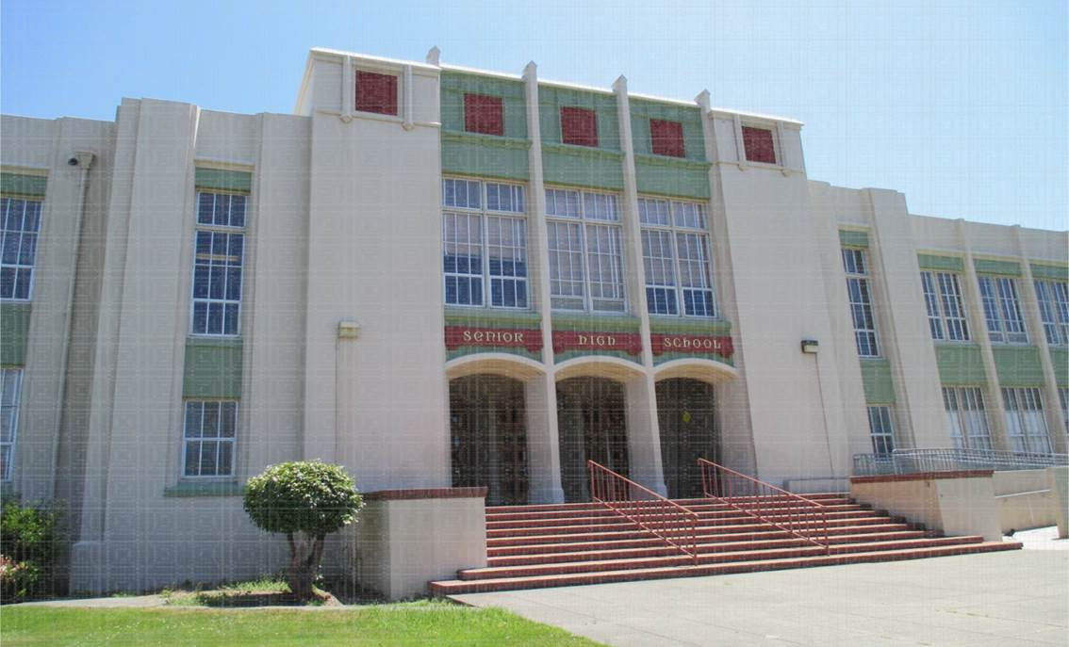

INTEGRATED PEST MANAGEMENT
FOR SCHOOLS
D E P A R T M E N T OF P E S T I C I D E R E G U L A T I O N
S C H O O L I P M P R O G R A M
Shasta Trinity Schools Insurance Group

Slide 2
Pesticide use in Education
https://www.youtube.com/watch?v=rfkzHv40Pz0

Slide 3




OUTLINE
Healthy Schools Act
What is IPM?
Safe Use of Pesticides in Schools
IPM Tool Belt
How to do IPM at Schools
Applicator Training Requirements

Slide 4







The Healthy Schools Act: Timeline
2001: AB 2260
Right-to-know law, K-12 public schools, public child care centers
2006: AB 405
  Prohibited certain pesticides at schools
2007: AB 2865
    Added PRIVATE CHILD CARE CENTERS (except
family day care homes)
2015: SB 1405
NEW • IPM plan, required IPM training,
schools report pesticide use

Slide 5





WHAT IS IPM?
Pest management strategy
Least hazardous pesticide used only as needed
Long-term prevention of pests
Combination of techniques
Health and environment approach

Slide 6















DOING IPM
Prevent
Keep Records
Monitor
Communicate
Take
Action
Identify

Slide 7



Why is IPM at Schools so Important?
Physiology
Bodies/brains still developing
Eat, breathe, & drink more per lb
Thinner skin
Behavior
Where and how they learn and play
Don’t recognize hazards
Curious, and cannot/will not read labels

Slide 8

Safe Pesticide Use at Schools
The Label is the LAW
Keep in original container
Don’t put in food/drink containers
Store immediately after use:
  -Well vented area
  -Locked container
  -Away from flames
Don’t take home, or bring in from home
Keep away from food, animal feed, PPE

Slide 9
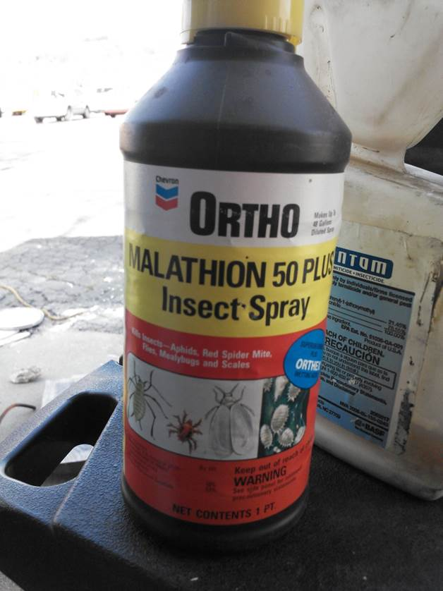
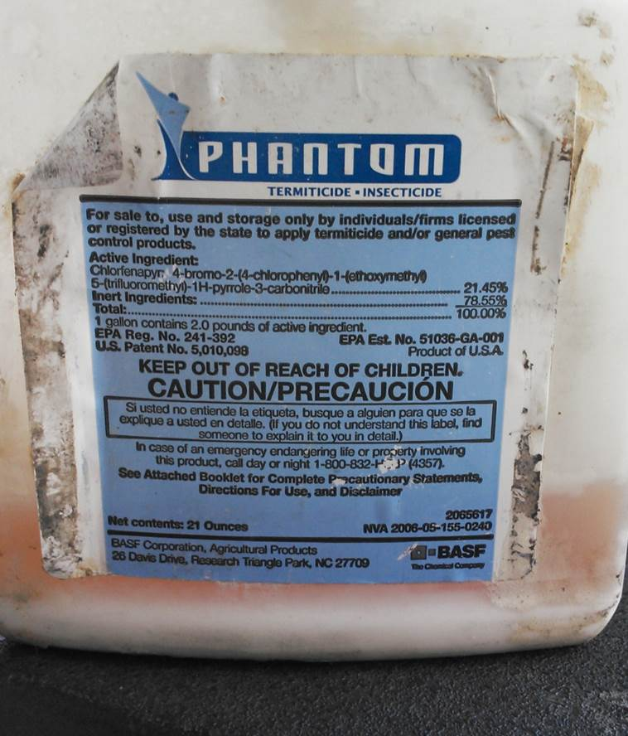
Found at a School in Shasta County

Slide 10
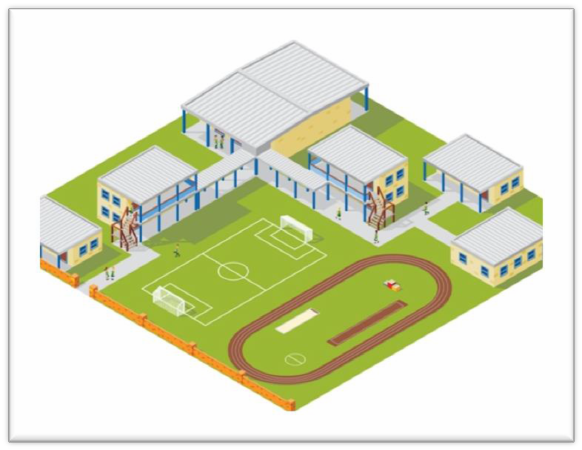

What is a SCHOOL SITE?
K-12 public school or public or
private child care center including…
buildings
playgrounds
fields
vehicles
or other locations used
for school purposes

Slide 11


HSA Requirements for…
Schools

Slide 12
HSA Requirements for Schools
Identify a “school designee”
  also known as the IPM Coordinator

Slide 13
HSA Requirements for Schools
Identify a “school designee”
Provide annual written notification
  All pesticides expected to be used

Slide 14
HSA Requirements for Schools
Identify a “school designee”
Provide annual written notification
Establish an individual notification
registry
  Provide notice 72 hrs. before all pesticides applications

Slide 15
HSA Requirements for Schools
Identify a “school designee”
Provide annual written notification
Establish an individual notification
registry
Post warning signs
  Posted at the area of application
  24 hours before / 72 hours after
  MUST be visible to all entering the area

Slide 16
HSA Requirements for Schools
Identify a “school designee”
Provide annual written notification
Establish an individual notification
registry
Post warning signs
Keep records
  4 years
  Warning sign info + amount of pesticide used

Slide 17
HSA Requirements for Schools
Identify a “school designee”
Provide annual written notification
Establish an individual notification
registry
Post warning signs
Keep records
Don’t use prohibited pesticides

Slide 18
HSA Requirements for Schools
Identify a “school designee”
Provide annual written notification*
Establish an individual notification
registry*
Post warning signs*
Keep records*
Don’t use prohibited pesticides*
*Includes pesticide applications made by
pest control contractor

Slide 19



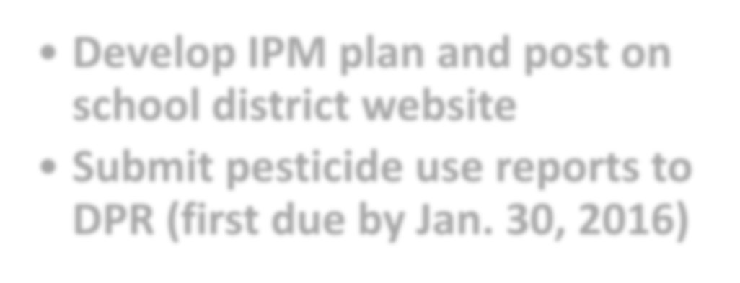


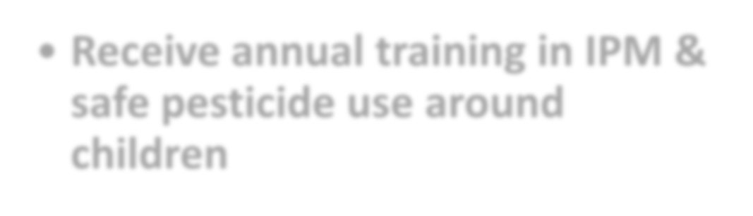
HSA Requirements for Schools
Starting January 1, 2015
Develop IPM plan and post on
school district website
Submit pesticide use reports to DPR (first due by Jan. 30, 2016)
Starting
July 1,
2016
Receive annual training in IPM & safe pesticide use around children

Slide 20
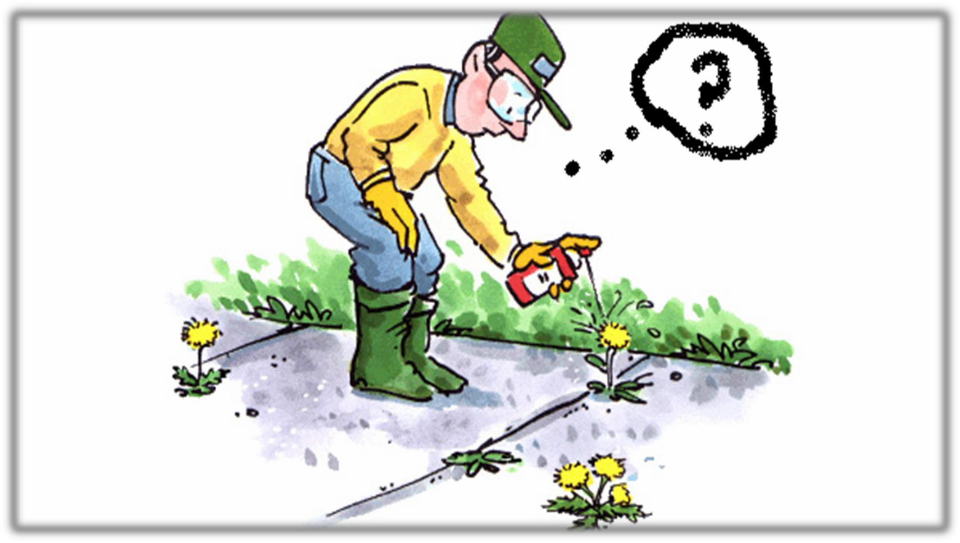
Frequently Asked Questions
about the Healthy Schools Act

Slide 21







Frequently Asked Questions
about the Healthy Schools Act

Slide 22





Frequently Asked Questions
about the Healthy Schools Act

Slide 23








Frequently Asked Questions
about the Healthy Schools Act

Slide 24
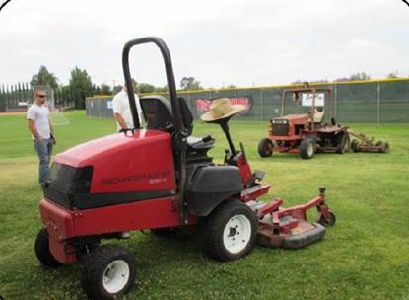

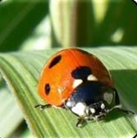
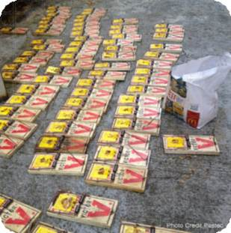
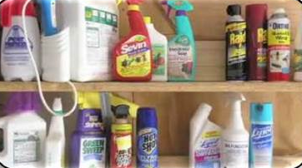
IPM TOOL BELT
Biological control
 The use of natural enemies
Cultural
 Methods that reduce pest establishment, reproduction, or survival
Physical
 Methods that kill or trap a pest directly
Chemical
 Reduced-risk pesticides only when needed

Slide 25
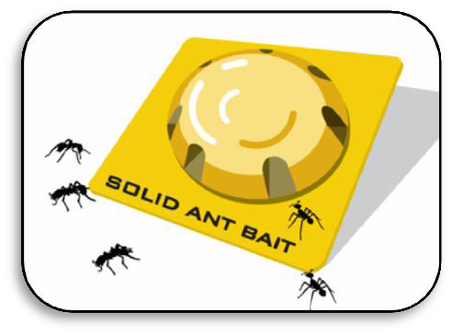
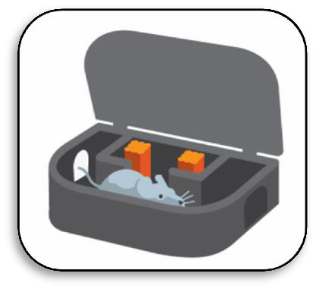


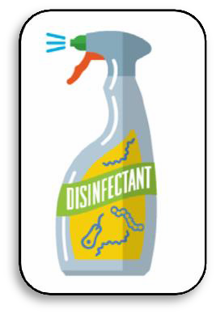
HSA: Exempt Pesticides
Gels/Pastes used as crack and crevice treatments
 Out-of-the-way places
 Reduced-exposure risk
Self-contained baits
 Only pest has access to bait
 Reduced-exposure risk
Exempt from federal
registration
 Botanical, food-grade ingredients
 Reduced-toxicity risk
Antimicrobials
 Sanitizers and
disinfectants
 Health and safety

Slide 26






Frequently Asked Questions
about the Healthy Schools Act

Slide 27
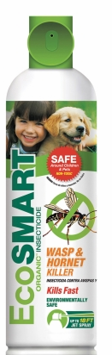
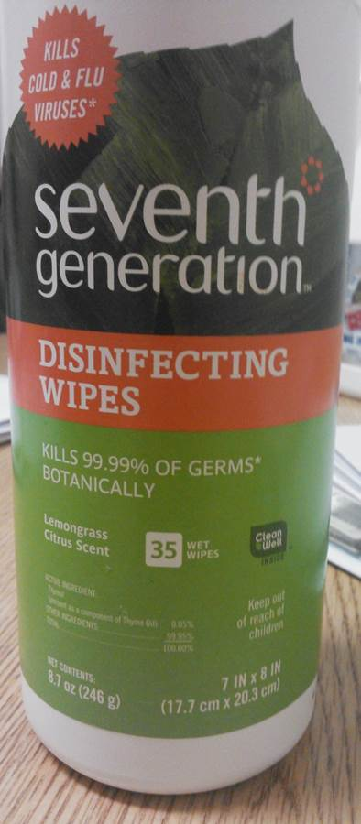
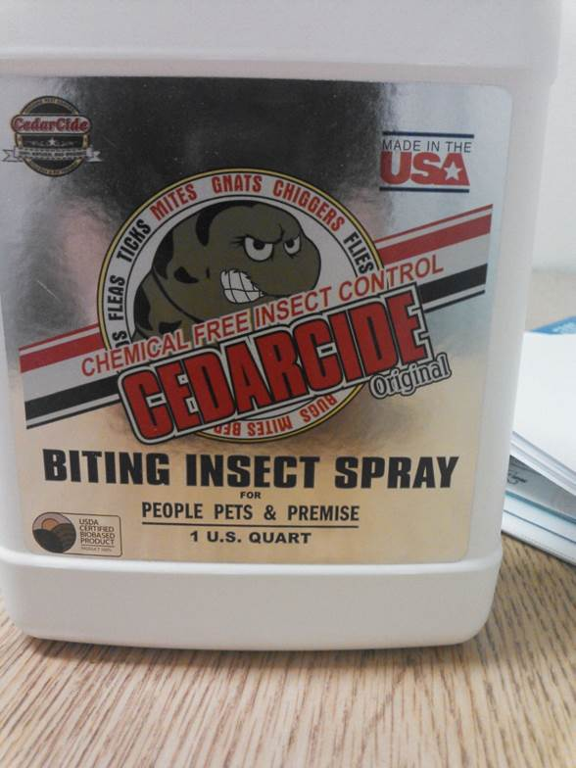
HSA: Exempt Pesticides

Slide 28




HSA: Exempt Pesticides
For Schools: No IPM plan, notification, posting, recordkeeping, or reporting required!
Reduced Exposure
Why are these exempt?
Reduced Toxicity Risk
Used for Health and Safety
*HSA training required if any pesticides are used.

Slide 29
Compatible with IPM
Caulking cracks for ant control
Ant baits
Incompatible with IPM
Treatment at regular time intervals
Insecticidal ant sprays (cans)

Slide 30
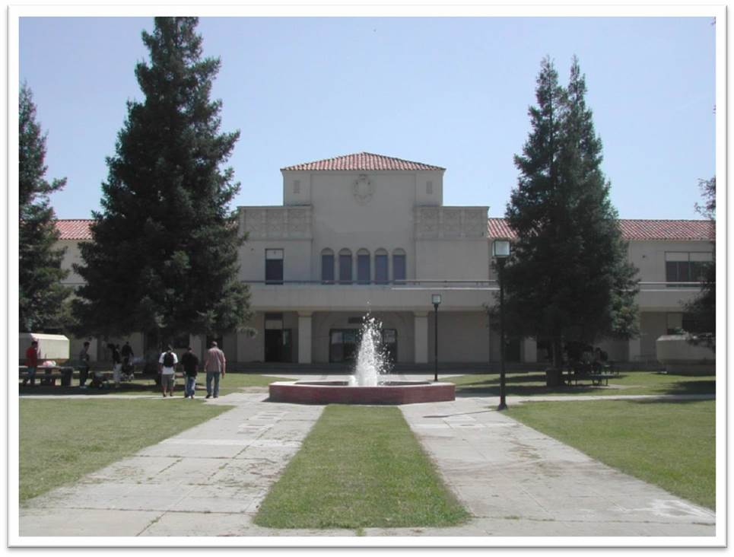
MANAGING PESTS AT
CALIFORNIA SCHOOL SITES

Slide 31

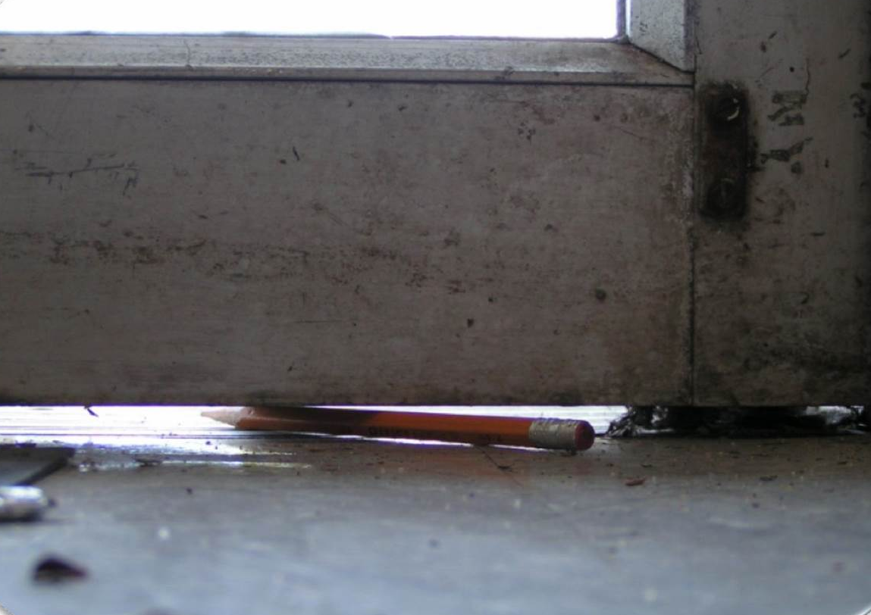
ELIMINATE ACCESS UNDER DOORS
How much space does a
mouse/rat need to get in?
¼ inch for a mouse mice (dime)
½ inch for a rat (quarter)

Slide 32

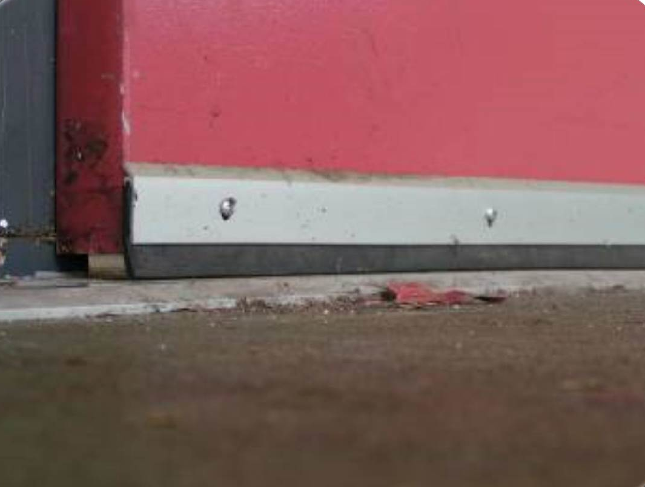
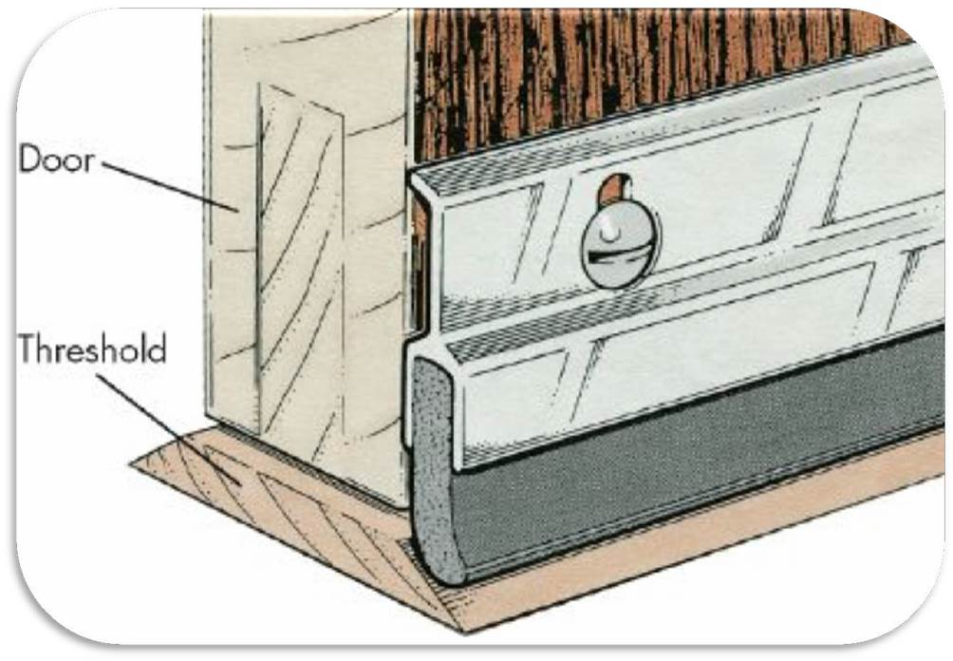
INSTALL DOOR SWEEPS
Why is this incorrect?

Slide 33

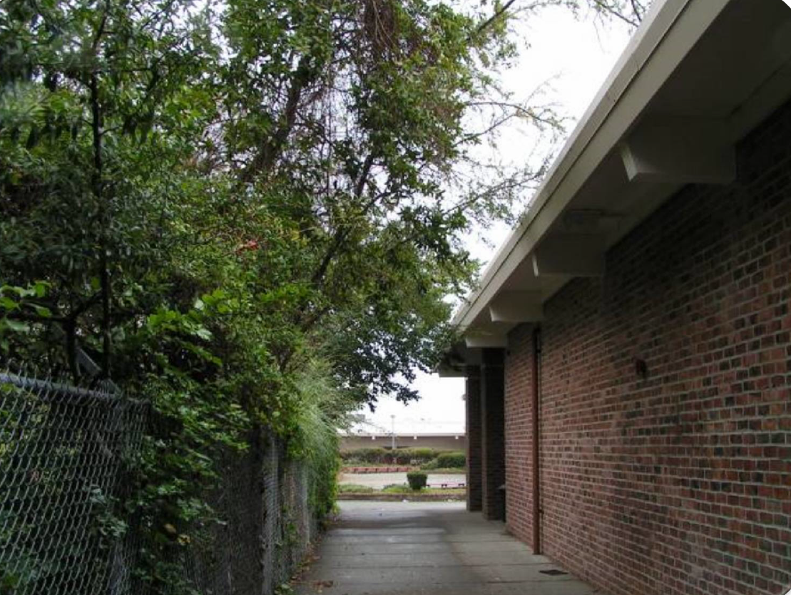
TRIM TREES AWAY FROM BUILDINGS
Prime roof access for rats and mice

Slide 34
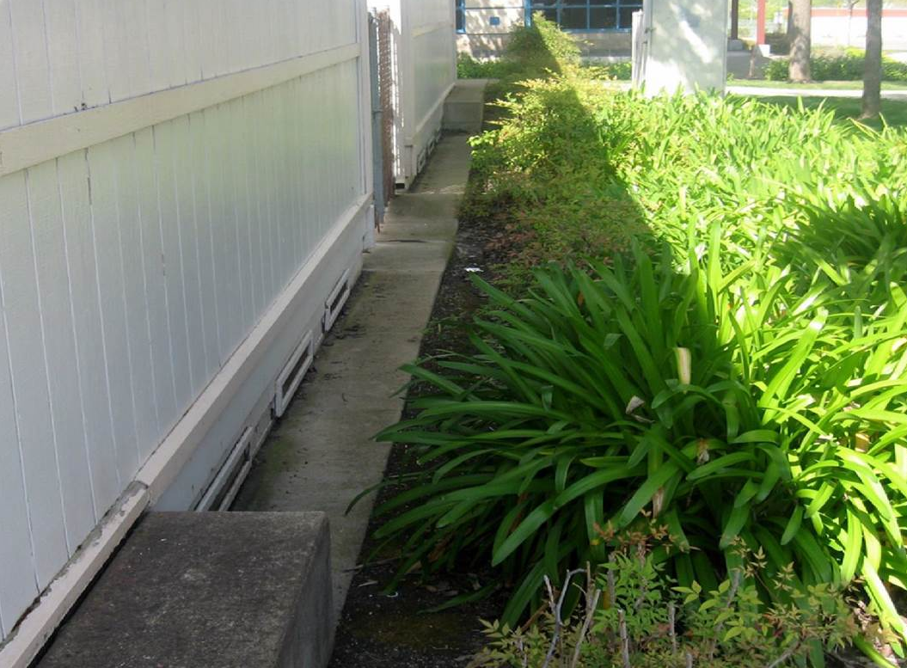
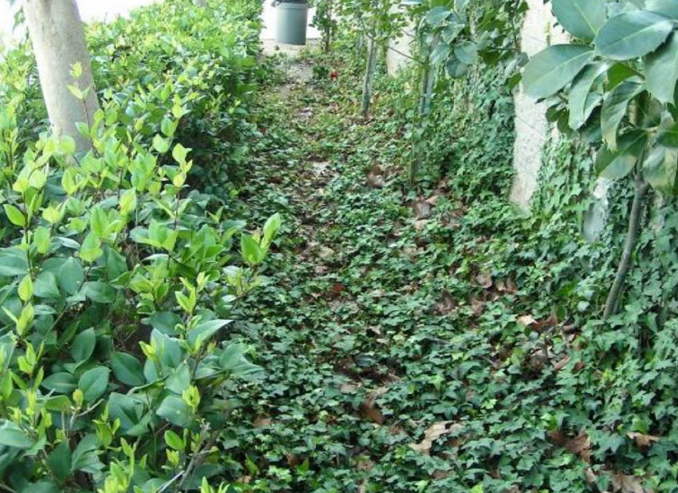
AVOID DENSE VEGETATION AGAINST
BUILDINGS
Why is this a bad choice?

Slide 35
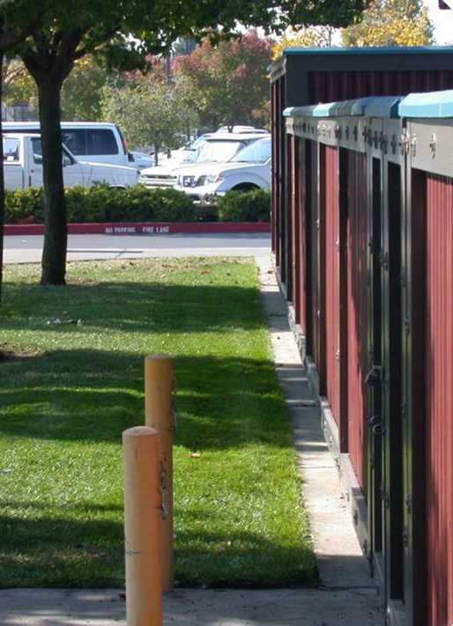
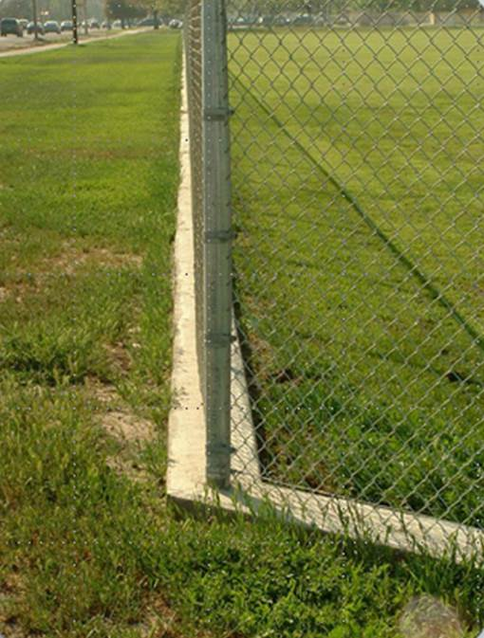
PREVENT WEEDS AT FENCELINES

Slide 36


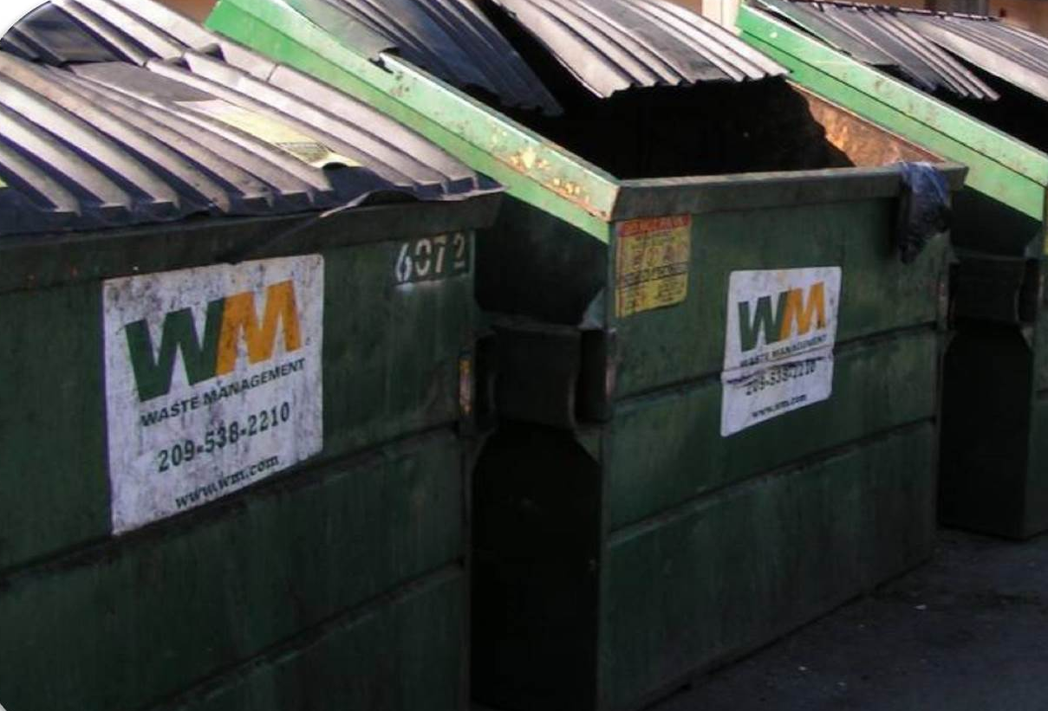
CLEAN WASTE & RECYCLING AREAS
Make sure lids are tight-
fitting and kept closed
Place at least 50 feet away from doors

Slide 37


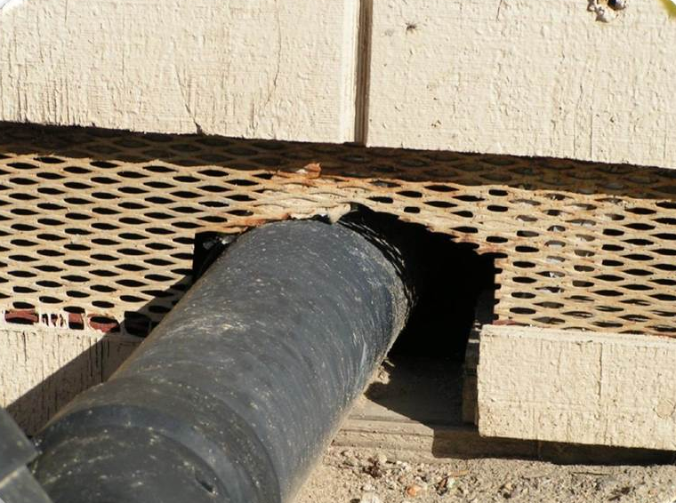
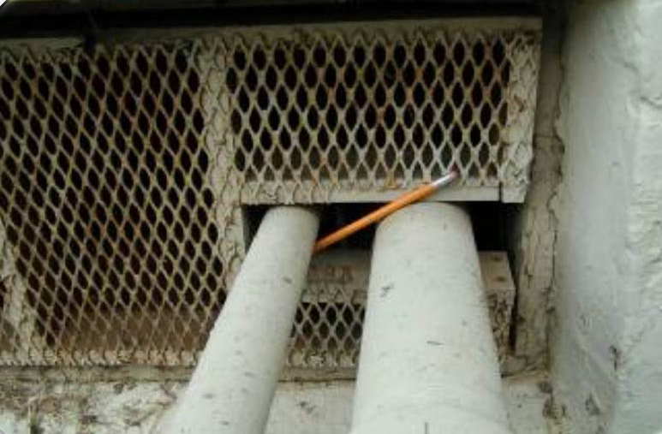
ELIMINATE GAPS IN WALL OPENINGS
✓Make sure to check rooftops and portables
✓Inspect areas after construction

Slide 38


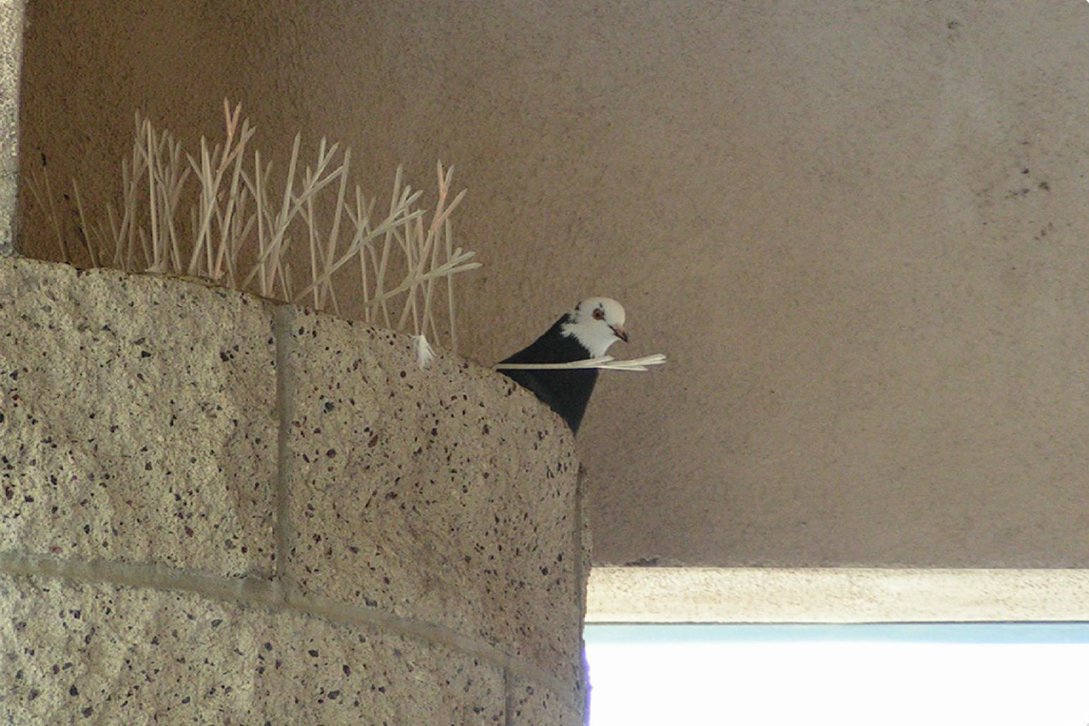
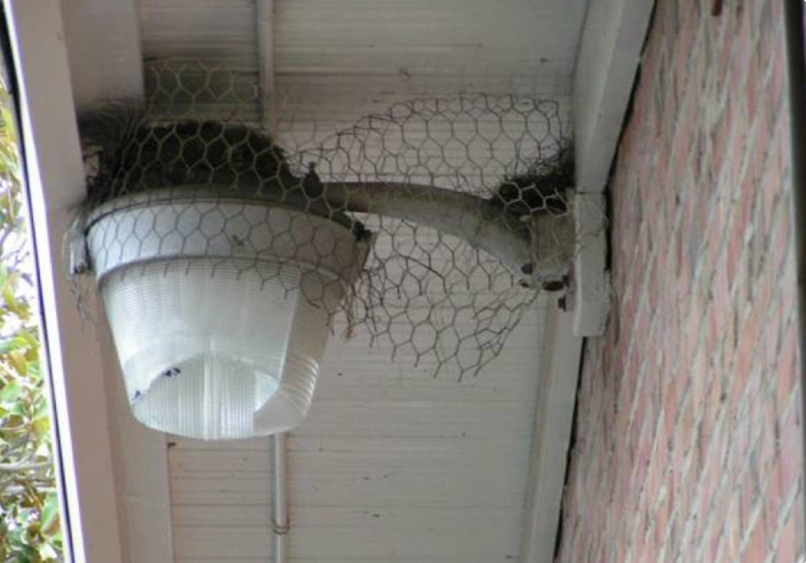
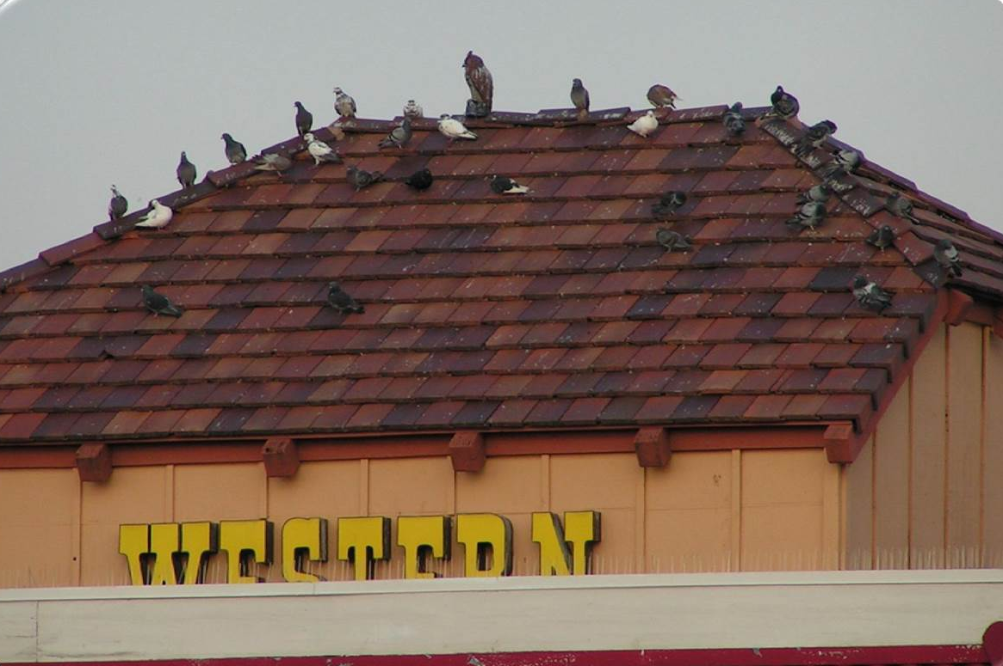
USE NETTING AND SPIKES FOR BIRDS
Do you know when to use netting vs. spikes?

Slide 39


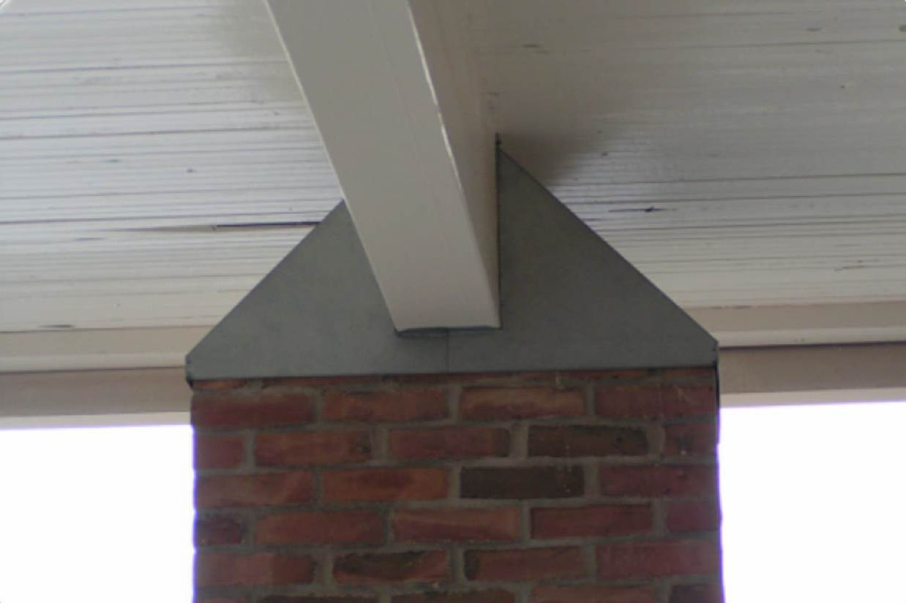
BUILD YOUR OWN DESIGN FOR BIRDS
Problem: The brick column was flat and attracted pigeons
Solution:
Build a
sloping cap

Slide 40


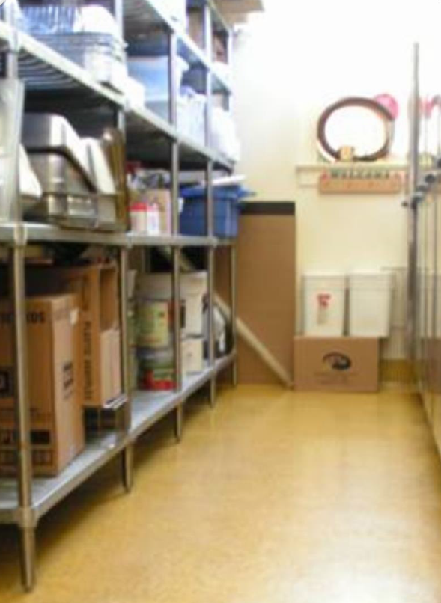
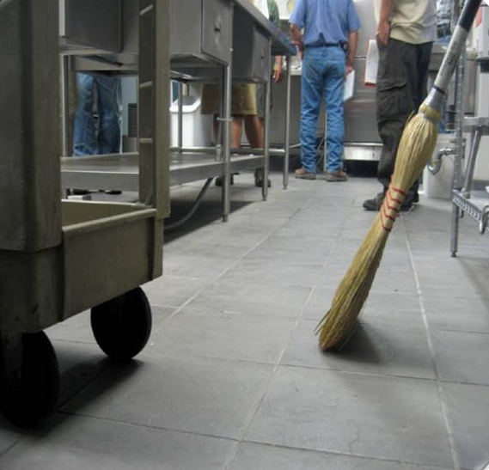
USE METAL SHELVING FOR STORAGE
Easier to clean
Does not absorb spills

Slide 41

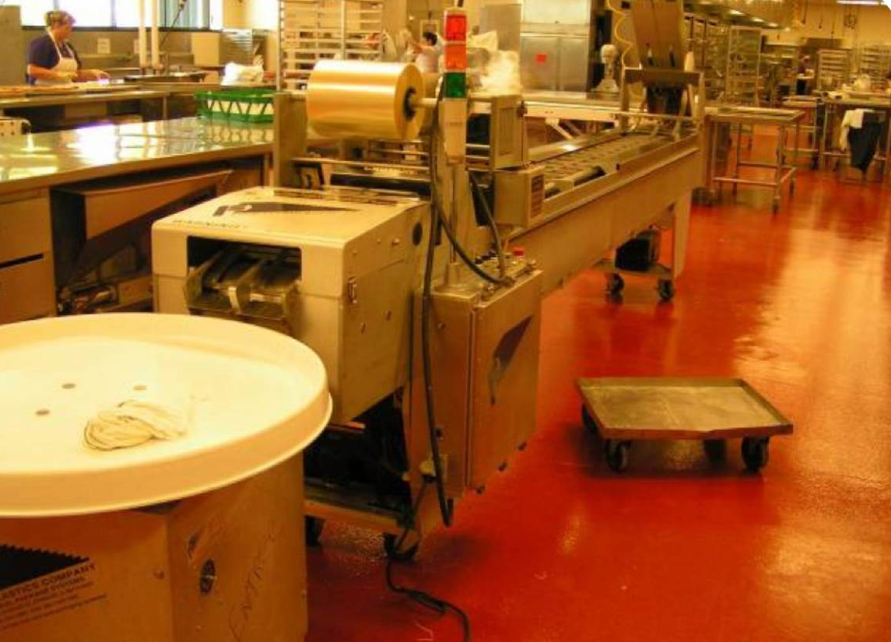
KEEP FOOD PREP AREAS CLEAN
Design for ease of inspection and cleaning

Slide 42

TRAINING REQUIREMENTS
Using Pesticides Safely
Emergencies and Health
Information for Employees

Slide 43


Basic Rules for Applicators
Wear clean work clothes daily: provided for and cleaned by employer if DANGER or WARNING signal word
PPE: Coveralls, Gloves,
Goggles Boots, Apron
Wear according to label
Use required respirator
Personal Hygiene: Wash hands before eating, smoking, drinking, or using bathroom.
Each day: Bathe thoroughly!

Slide 44
Safe Handling
Opening
Lifting
Pouring
Mixing
Controlling Drift
Triple Rinsing
Storing
Moving and hand-pouring concentrates is most dangerous parts of using pesticides

Slide 45
Emergencies
Before: check label, MSDS, SDS
First Aid/Decon. procedures
-Skin -Eyes -Inhalation -Ingestion -Symptoms -Immediate and long term effects
Spills
Leaks
Fires
Must be Posted: Emergency Medical Info, Policies
For collapsed worker:
Get person away from pesticide *Bring container
Call 911 to doctor
Give CPR
Swallowed pesticide: Eyes:
Call 911 Call 911
Take to hospital Rinse/flush
DO NOT INDUCE VOMITING

Slide 46

Heat Stress
Hydrate
Work in shifts
Avoid working during hottest part of day
  Restricted above 80° day, 85 ° night!
Effects are cumulative
Don’t sacrifice PPE for comfort

Slide 47
Information for Employees
Laws and Regulations
  Employer is REQUIRED to train you
  Must have access to a written training program
  HAZCOM/GHS plan available
MSDS/SDS available to all employees
http://apps.cdpr.ca.gov/schoolipm/

Slide 48


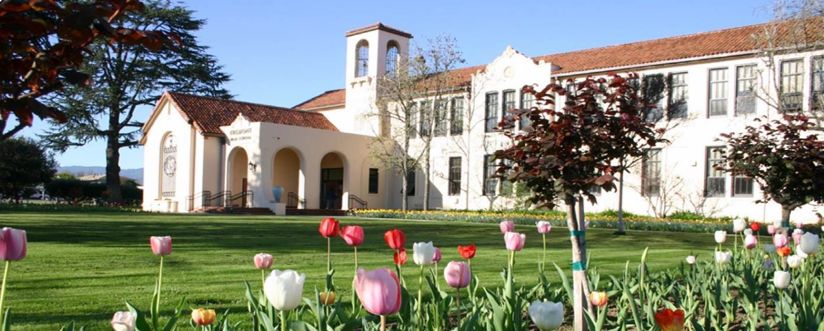
Contact the School IPM Program with questions:
Email:

