Slide 1
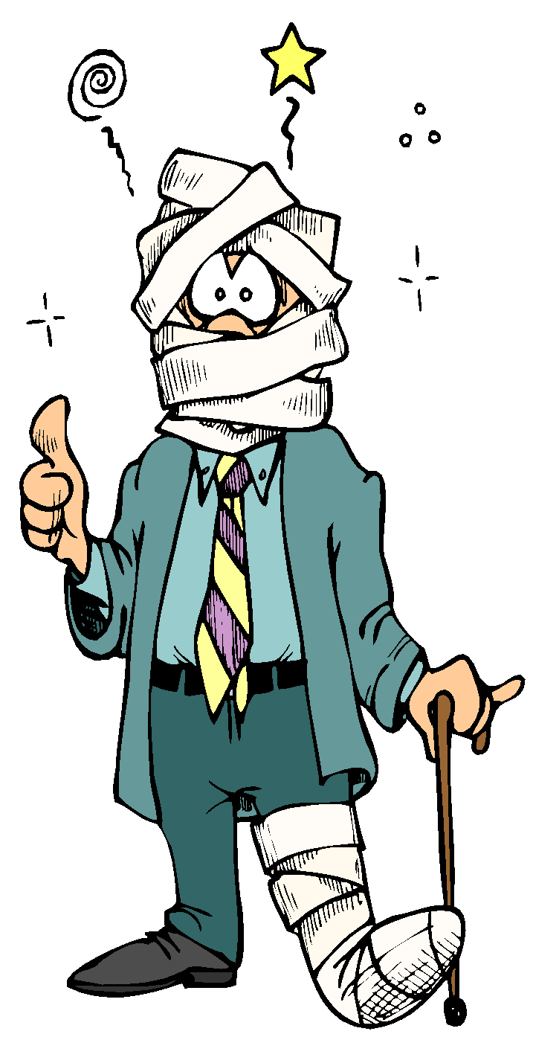
Injury and Illness Prevention Plans
Creating and maintaining your IIPP

Slide 2
Agenda
Introduction
The “Big 8”
How to make your IIPP EFFECTIVE
Keeping your IIPP up to date
Lets build an IIPP!

Slide 3
Introduction
Learning Outcomes:
At the end of this training you will be able to:
  -Explain what an IIPP is
  -Explain why it is important to have one
  -Create and update an IIPP

Slide 4
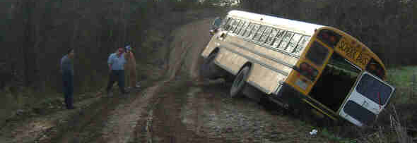
Preventable Hazards
Every day in the United States, over 18,000 people are injured or made ill on the job from hazards that are almost entirely preventable.
See more at: http://lohp.org (Labor Occupational Health Program)

Slide 5
What is an IIPP?
IIPP: A written workplace safety program
Required by title 8, section 3203 of the California Code of Regulations
Must be implemented and effective

Slide 6
History of IIPPs
1987-1989: Budget cuts result in Cal/OSHA failing to enforce workplace safety standards
Federal enforcement and safety standards were found to be weak and unenforceable
Workers Comp reforms did not adequately address workers safety
1989: CA Gov. Deukmejian signs SB198 to detail requirements for safety programs
July 1, 1991 written IIPP required by all employers with >10 workers

Slide 7
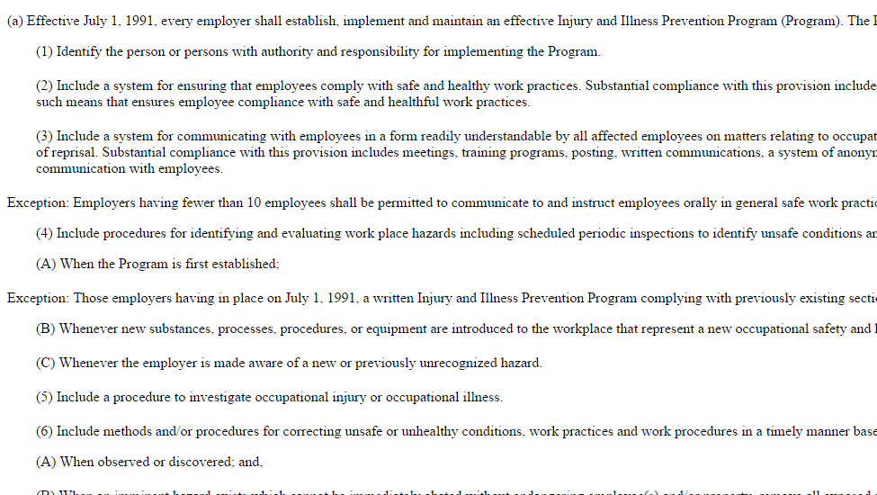
Why an IIPP?
An effective IIPP can reduce or prevent expensive injuries and illness
It’s the LAW!

Slide 8
Why Should I Care?
INJURY
Affects on YOU
Pain
Loss of income
Preventable
Slower job advancement
Suffering
Affects on EMPLOYER
High Work Comp premiums
Medical treatment costs
Accident
Indemnity
Illness
Litigation
Reduced funds for raises/operating costs

Slide 9


Cost of Common Injuries
Carpal Tunnel/Repetitive Motion injury: $40,000
Back injury: $50,000
Slip and fall injury: $62,000

Slide 10
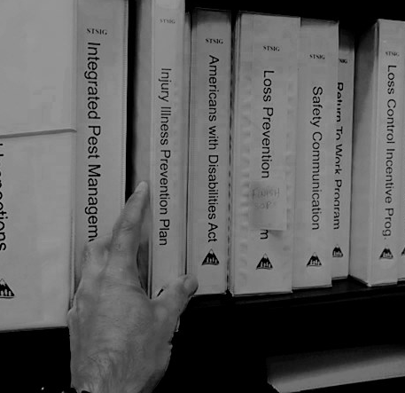
The “Big 8”
1: Responsibility
2: Compliance
3: Communication
4: Hazard Assessment
5: Hazard Correction
6: Accident/Exposure investigation
7: Training and Instruction
8: Record Keeping

Slide 11
The “Big 8”
#1: Responsibility
One of the most important parts
Indicates by NAME or JOB TITLE who is personally responsible for implementing and maintaining the IIPP in your organization
All supervisors and managers responsible in their areas too

Slide 12
The “Big 8”
#2: Compliance
Mandates safe work practices
Mandates following all directives, policies, procedures
Plan to reward good performance, train those deficient
Outlines discipline procedures

Slide 13
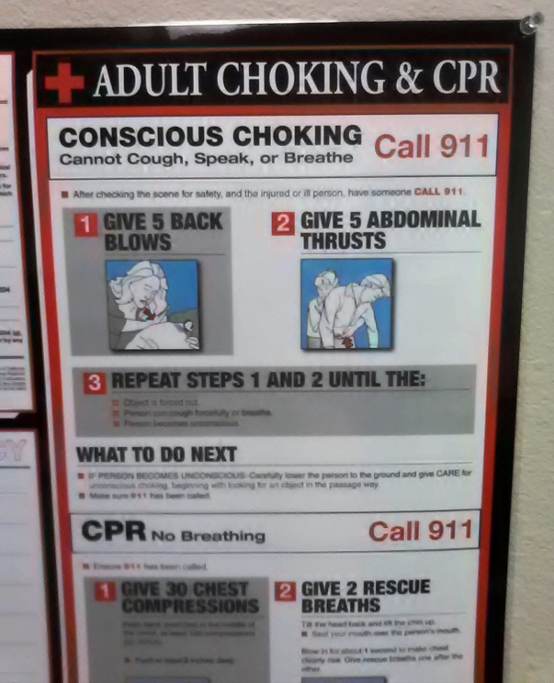
The “Big 8”
#3: Communication
Readily understandable by employees
ID issues: no fear of reprisal
  (anonymous reporting)
New employee orientation
IIPP reviews
Safety training programs
Safety meetings
Posted/distributed safety information
Safety committee (optional)

Slide 14

The “Big 8”
#4: Hazard Assessment
Periodic inspection process
Inspection schedule and who is responsible can be in dept. supplements
ALSO As Required inspections:
  When new hazards are introduced
  When occupational injuries and illnesses occur
  As conditions warrant

Slide 15


The “Big 8”
#5: Hazard Correction
Plan to correct unsafe or unhealthy work conditions, practices and procedures
Must be in timely manner and prioritized based on severity
Protection from immediate threats
Mitigation standards

Slide 16

The “Big 8”
#6: Accident/Exposure investigation
Your procedures to:
  Interview employees/witnesses
  Examine workplace factors
  Determine causes
  Take corrective action
  Record findings

Slide 17
The “Big 8”
#7: Training and Instruction
Policies and procedures for general/job specific safety training*
Supervisor and manager training
New employees or re-assignments
New substances, operations, equipment
*Can be department specific, located in Dept. supplement

Slide 18
The “Big 8”
3 yrs
#8: Record Keeping
Safety training: Names, dates, type, provider
Inspections: inspector(s), issues, corrections, follow-up
Accidents, illnesses, near miss inspections
Safety committee meeting minutes (if you have one)
Annual program reviews
Use pre-formatted forms!

Slide 19
Department Supplements
Each major department* should have one:
Follows same 8 paragraph format
Lists responsible persons
Can use a simpler “Standard” format or more detailed plan
Contains department-specific hazards and policies
*think: “School Site”

Slide 20
A Effective IIPP
You can ensure your IIPP is effective by:
Fully involving all employees, supervisors and management
Identify specific workplace hazards
Correct identified hazards in an appropriate and timely manner

Slide 21
A Effective IIPP (1 of 4)
Effectiveness Questions (form on CALOSHA website):
Are employees made aware of who is the person with authority and responsibility for their IIPP and can they access the person if they want to?
Are employees recognized for performing safe and healthful work practices?
Are employees disciplined for performing unsafe or unhealthful work practices?
Are employees given training or re-training to ensure compliance with safe and healthful work practices?

Slide 22
A Effective IIPP (2 of 4)
Effectiveness Questions (form on CALOSHA website):
Do employees know and use the organizations methods of communication to inform management about health and safety matters?
Does our organization use a labor/management safety and health committee to comply with the communication requirements of subsection (a)(3) of T8CCR 3203?
Does our organizations labor/management safety and health committee meet all the requirements of T8CCR 3203 (7) (c) (1) – (7)?

Slide 23
A Effective IIPP (3 of 4)
Effectiveness Questions (form on CALOSHA website):
Does our organization’s periodic inspections for hazard assessment result in a comprehensive evaluation of any hazards present at our workplace?
Does the use of our organization’s investigation procedures result in:
a) the determination of the cause (s) of accidents, hazardous substance exposures, and nearmisses
  followed by
b) effective corrective actions being taken in a timely manner?

Slide 24
A Effective IIPP (4 of 4)
Effectiveness Questions (form on CALOSHA website):
Do we use our organization’s procedures to correct identified hazards in a timely manner based on the severity of the hazard?
Does our organization provides effective training to instruct employees and supervisor’s on general safe work practices and on the hazards specific to their job assignments and work tasks?
Does our organization’s effective training result in an increase in employee’s and supervisor’s understanding of workplace hazards and improvements in their safe and healthful work practices?

Slide 25
IIPP Workshop
CALOSHA website: http://www.dir.ca.gov/DOSH/etools/09-031/how.htm
Additional Documents (See handouts)
  Sample IIPP and Effectiveness Questionnaire
  Training subjects
  Worker training record
  Sample Code of Safe Practices
  Investigation report
  Hazard assess checklist (can download/modify)
  ID Hazards record (can download/modify)

Slide 26
Employer Code of Safe Practices
All persons shall follow these safe practice rules, render every possible aid to safe operations, and report all unsafe conditions or practices to the Loss Prevention Manager or the Director.
Leaders shall insist on employees observing and obeying every rule, regulation, and order as is necessary to the safe conduct of the work, and shall take such action as is necessary to obtain observance.
All employees shall be given frequent accident prevention instructions. Instructions shall be given at hire and as situations warrant, but in no event less than twice annually.
Anyone known to be under the influence of drugs or intoxicating substances that impair the employee's ability to safely perform the assigned duties shall not be allowed on the job while in that condition.
Horseplay, scuffling, and other acts that tend to have an adverse influence on the safety or well-being of the employees shall be prohibited.
Work shall be well planned and supervised to prevent injuries in the handling of materials and in working together with equipment.
No one shall knowingly be permitted or required to work while the employee's ability or alertness is so impaired by fatigue, illness, or other causes that it might unnecessarily expose the employee or others to injury.
Employees shall be instructed to ensure that all guards and other protective devices are in proper places and adjusted, and shall report deficiencies promptly to Loss Prevention Manager or the Director.
Workers shall not handle or tamper with any electrical equipment, machinery, or air or water lines in a manner not within the scope of their duties.
All injuries shall be reported promptly so that arrangements can be made for medical or first aid treatment.
When lifting heavy objects, the large muscles of the leg instead of the smaller muscles of the back shall be used.
Inappropriate footwear or shoes with thin or badly worn soles shall not be worn.
When operating vehicles, drivers should obey all traffic laws, be aware of weather considerations, and drive defensively.

Slide 27
Exceptions To IIP Requirements
CALOSHA website: http://www.dir.ca.gov/dosh/etools/09-031/exceptions.htm
Establishments with < 20 employees during the calendar year and in an industry not on the designated high hazard list and who have a Worker's Compensation Experience Modification Rate (ExMod) of 1.1% or less; and Establishments with < 20 employees during the calendar year on a designated List of Low Hazard Industries can limit written documentation of the IIPP to the following requirements:
-The identity of the person(s) with authority and responsibility for program implementation as required by T8CCR 3203 (a)(1),
-Scheduled periodic "inspections" to identify unsafe conditions and work practices as required by T8CCR 3203 (a)(4),
-Training and instruction provided to employees as required by T8CCR 3203 (a)(7)

Slide 28
Exceptions To IIP Requirements
CALOSHA website: http://www.dir.ca.gov/dosh/etools/09-031/exceptions.htm
Local government entities are not required to keep records of the steps taken to implement and maintain their IIPP. Local government entities include:
Counties, cities, districts
Public or quasi-public corporations
Public agencies,
Any public entity, other than a state agency, that is a member of, or created by, a joint powers agreement
ALL PUBLIC AND PRIVATE SCHOOLS FALL UNDER IIPP

Slide 29
Resources
Kurt Walling, Loss Prevention Manager
  530-221-6444
  kwalling@stsig.org
  www.stsigjpa.com
Department of Industrial Relations
  http://www.dir.ca.gov
SASH (School Action for Safety and Health)
  www.lohp.org
  March 23, 2015 9am-4pm – SASH training in Stanislaus.
  Donna Iverson at 510-643-8902 or driver@berkeley.edu.

Slide 30

Questions?

