Slide 1
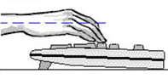
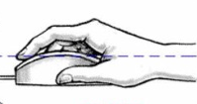
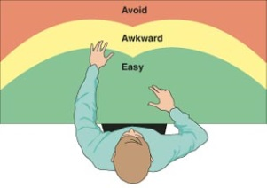

Ergonomics Tips
Ergonomics Tips
Top of monitor at eye level
“Float” when typing/mousing
Sit back, use whole chair
Avoid awkward postures (cradling phone, twisting, leaning)
20-20-20! Every 20 minutes take 20 sec to look 20 ft away OR take a 20 sec break.
Avoid overreaching
Top of monitor at eye level
“Float” when typing/mousing
Sit back, use whole chair
Avoid awkward postures (cradling phone, twisting, leaning)
20-20-20! Every 20 minutes take 20 sec to look 20 ft away OR take a 20 sec break.
Avoid overreaching
Kurt Walling, Loss Prevention Manager kwalling@stsig.org/www.stsig.com
Kurt Walling, Loss Prevention Manager kwalling@stsig.org/www.stsig.com
Ergonomics Tips
Ergonomics Tips
Top of monitor at eye level
“Float” when typing/mousing
Sit back, use whole chair
Avoid awkward postures (cradling phone, twisting, leaning)
20-20-20! Every 20 minutes take 20 sec to look 20 ft away OR take a 20 sec break.
Avoid overreaching
Top of monitor at eye level
“Float” when typing/mousing
Sit back, use whole chair
Avoid awkward postures (cradling phone, twisting, leaning)
20-20-20! Every 20 minutes take 20 sec to look 20 ft away OR take a 20 sec break.
Avoid overreaching
Kurt Walling, Loss Prevention Manager kwalling@stsig.org/www.stsig.com
Kurt Walling, Loss Prevention Manager kwalling@stsig.org/www.stsig.com

Slide 2
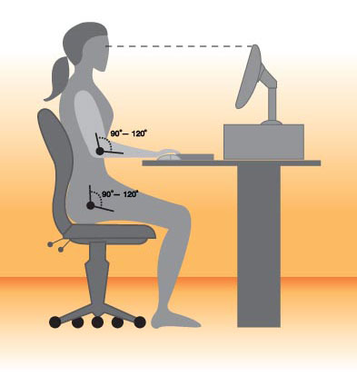
Ergonomics Tips
Ergonomics Tips
Maintain proper body position
Maintain proper body position
Eyes level with top of screen
Eyes level with top of screen
Back straight
Back straight
Wrists straight
Wrists straight
Hips level with or higher than knees
Hips level with or higher than knees
2 inch space
2 inch space
Feet flat on floor or footrest
Feet flat on floor or footrest
Kurt Walling, Loss Prevention Manager kwalling@stsig.org/www.stsig.com
Kurt Walling, Loss Prevention Manager kwalling@stsig.org/www.stsig.com
Ergonomics Tips
Ergonomics Tips
Maintain proper body position
Maintain proper body position
Eyes level with top of screen
Eyes level with top of screen
Back straight
Back straight
Wrists straight
Wrists straight
Hips level with or higher than knees
Hips level with or higher than knees
2 inch space
2 inch space
Feet flat on floor or footrest
Feet flat on floor or footrest
Kurt Walling, Loss Prevention Manager kwalling@stsig.org/www.stsig.com
Kurt Walling, Loss Prevention Manager kwalling@stsig.org/www.stsig.com

