Slide 1
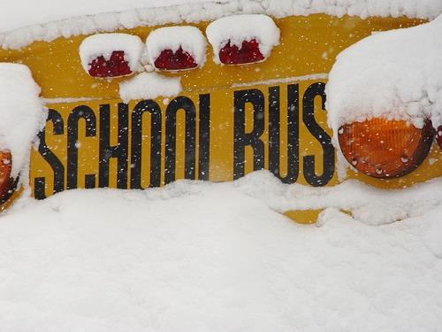
Cold Weather
Safety

Slide 2
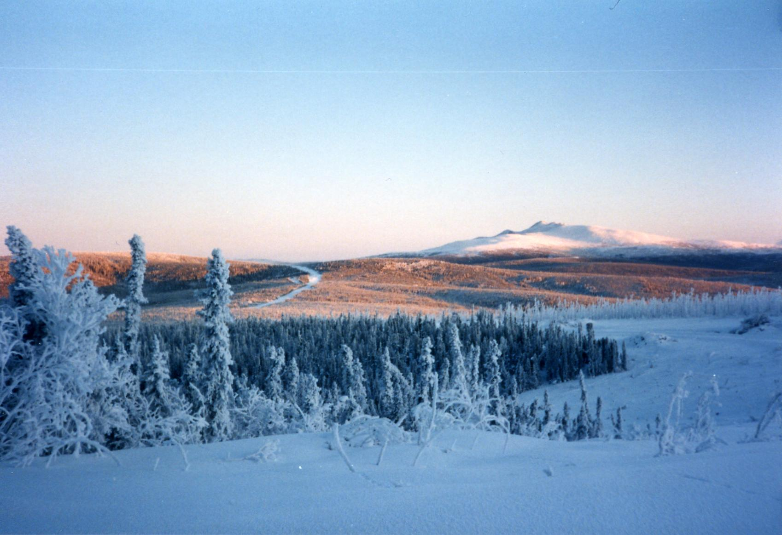
Cold Weather Considerations
Individual Care in a Cold or Mountainous Environment
  Environmental Factors
  Heat Loss
  Body Response to the Cold Weather Environment
  Individual Factors
  Food and Water Requirements
  C.O.L.D.
Cold Weather Injuries
  Recognition
  Symptoms
  Treatment
  Prevention

Slide 3
Environmental Factors
Severe, unpredictable weather
Extreme temperatures
Humidity – Wet Cold vs. Dry Cold
Altitude
Wind Chill - The combined cooling effect of ambient temperature and wind velocity on a surface

Slide 4
Redding Climate Data
Climate data for Redding, California (1961–1990)
Month | Jan | Feb | Mar | Apr | May | Jun | Jul | Aug | Sep | Oct | Nov | Dec | Year
Average high °F (°C) | 57.3 (14.1) | 61.3 (16.3) | 62.5 (16.9) | 69.9 (21.1) | 80.5 (26.9) | 90.4 (32.4) | 98.3 (36.8) | 95.7 (35.4) | 89.3 (31.8) | 77.6 (25.3) | 62.1 (16.7) | 54.7 (12.6) | 74.97 (23.86)
Daily mean °F (°C) | 45.5 (7.5) | 50.7 (10.4) | 52.5 (11.4) | 58 (14) | 66.4 (19.1) | 76.1 (24.5) | 81.5 (27.5) | 79.5 (26.4) | 74.1 (23.4) | 63.5 (17.5) | 51.8 (11) | 45 (7) | 62.05 (16.64)
Average low °F (°C) | 35.7 (2.1) | 40 (4) | 41.7 (5.4) | 46 (8) | 52.3 (11.3) | 61.8 (16.6) | 64.7 (18.2) | 63.1 (17.3) | 58.8 (14.9) | 49.2 (9.6) | 41.4 (5.2) | 35.2 (1.8) | 49.16 (9.53)
Precip. inches (mm) | 6.06 (153.9) | 4.45 (113) | 4.38 (111.3) | 2.08 (52.8) | 1.27 (32.3) | 0.56 (14.2) | 0.17 (4.3) | 0.46 (11.7) | 0.91 (23.1) | 2.24 (56.9) | 5.21 (132.3) | 5.51 (140) | 33.3 (845.8)
Avg. precipitation days | 13.1 | 8.7 | 12.3 | 7.9 | 7.2 | 4.0 | 0.6 | 0.9 | 2.1 | 4.1 | 6.8 | 10.2 | 77.9
Mean monthly sunshine hours | 226 | 256 | 312 | 351 | 395 | 423 | 451 | 421 | 338 | 314 | 251 | 204 | 3,942
Source: ^{[12]}
Record Low Temperature:
7 degrees F

Slide 5
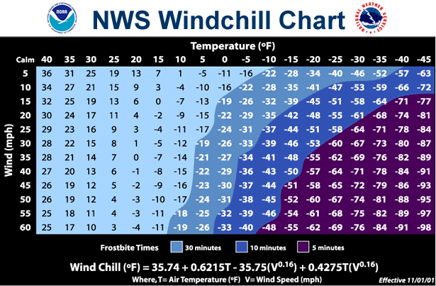
Risk Of Frostbite, 5ºF, 30 MPH wind

Slide 6
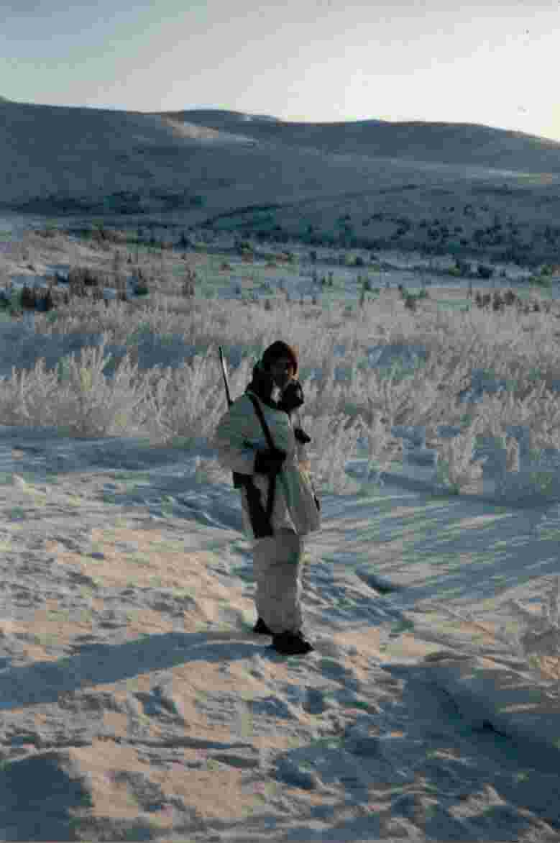
How does the body lose heat?
Radiation - 60%
Convection – variable
Conduction – variable
Respiration - 6% - 10%
Evaporation - 12% - 15%

Slide 7
Body Response to the Cold Weather Environment
Shell/Core Effect
-Body pulls blood from extremities to keep the core warm.
Cold Diuresis
Kidneys sense increase of volume in core
Increased urination
Thirst mechanism is also disrupted

Slide 8
Individual Factors
Age Geographic Origin
Discipline Psycho-Social Factor
Training Fatigue
Experience Activity
Drugs Nutrition
Previous Cold Injuries Other Injuries

Slide 9
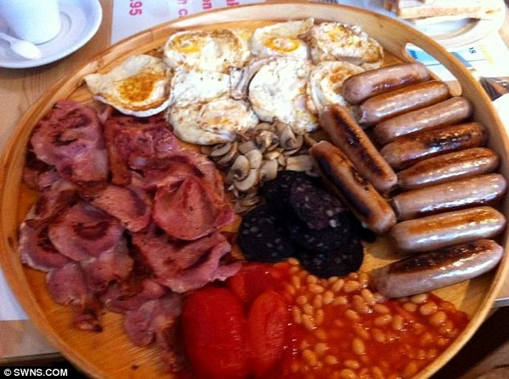
Food and Water Requirements
Calories – 4500-6,000 calories per day
Fats and proteins
Hot meals
Vitamins
3.5-5 quarts of water per day

Slide 10
Remember: COLD!
Clean: Keep your clothing clean
Overheating: Avoid overheating and sweating
Loose in Layers: Dress in loose layers
Dry: Stay dry

Slide 11
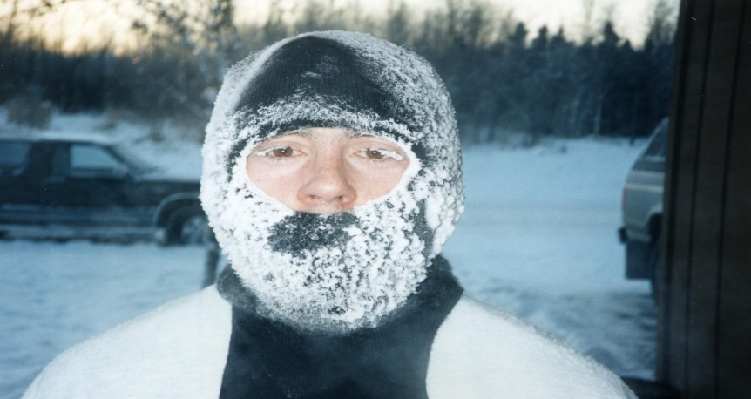
Dehydration
What is it? Excessive loss of body fluids. Shell/core effect Cold diuresis Overdressing | Symptoms: Headache, Dizziness, Rapid heartbeat, Painful urination, Constipation, Lack of appetite, Darkening of urine, Fatigue
Prevention: Drink 3.5-5 qts water per day. Monitor the color of urine -Light to straw colored ok -Dark brown is trouble | Treatment: -Replace lost water slowly -In extreme cases medical treatment and IV may be necessary -Electrolites

Slide 12

Hypothermia
What is it? Excessive heat loss Body cannot replace heat HAPPENS IN TEMPERATURES ABOVE FREEZING! | Symptoms: MILD: Uncontrollable shivering, body temp. 90-96º F irrational thought patterns; false sense of warmth; personality changes SEVERE: lack of shivering, body temperature below 90º F and a severely altered mental state
Prevention: Apply COLD principles Proper wear of clothing Anticipate need for shelter Hydration Nutrition | Treatment: MILD: Reduce cold challenge, add heat External Heat Exercise Eat SEVERE: Evacuate individual to medical care.
E

Slide 13
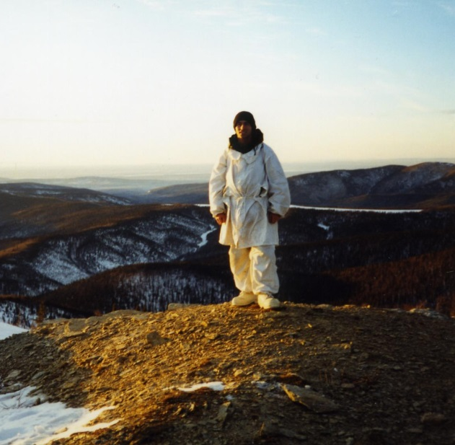
Chilblain
What is it? Excessive exposure to cold temperature -Inflammatory swelling of hands and feet -Severe itching and burning sensations -Ulceration -Affects individuals with a history of cold limbs | Symptoms: Swollen red tissue (light skinned individuals) Darkening of the skin (darker skin types). This injury DOES NOT involve freezing of tissue.
Prevention: Proper wear of clothing Proper hydration and nutrition | Treatment: Warm with direct body heat Do not massage or rub Do not wet area or rub with snow or ice Do not expose to any intense direct heat source

Slide 14
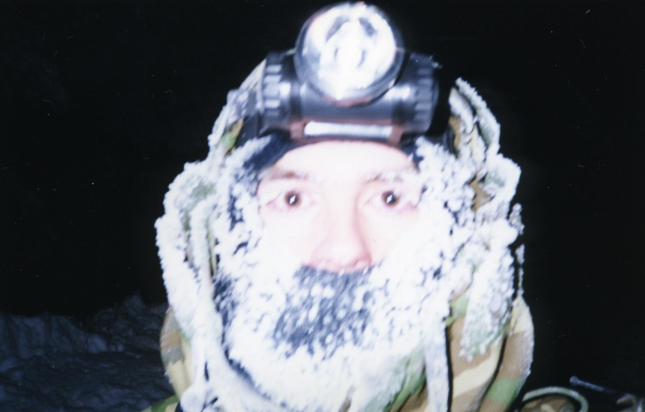
Frostbite
What is it? Freezing of body tissue. Ambient temperature MUST be below 32º F Superficial (frostnip) – only the outer layer of skin is affected Deep – more tissue involved; can be down to and include bone | Symptoms: Superficial (frostnip) – waxy, white or gray skin (pink or red in dark skinned persons) pliable underlying layers Deep frostbite - white or bluish and firm to the touch, will not move over underlying layers.
Prevention: Proper wear of clothing Contact gloves Approved gloves to handle POL Keep face and ears covered and dry Avoid alcohol and tobacco products COLD! | Treatment: Superficial - warm area with direct body heat or use water at approx 105º F; do not allow tissue to re-freeze; Deep - DO NOT thaw. Do not allow to re-freeze or bear weight Evacuate NEVER moisten or rub with snow/ice; do not expose to intense heat source

Slide 15
Examples
The following pictures are graphic and are of people who have suffered frostbite and other cold weather injuries. Please prepare yourself.

Slide 16
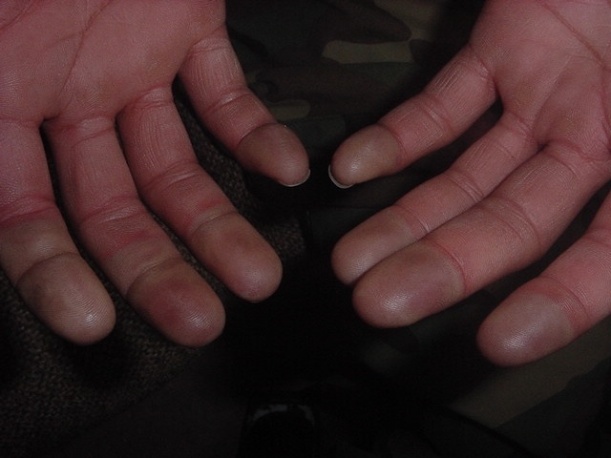
Mild Frostbite; fingerless gloves

Slide 17
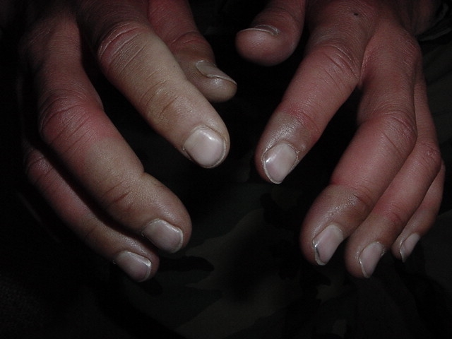
Can result instantly from contact with fuel

Slide 18
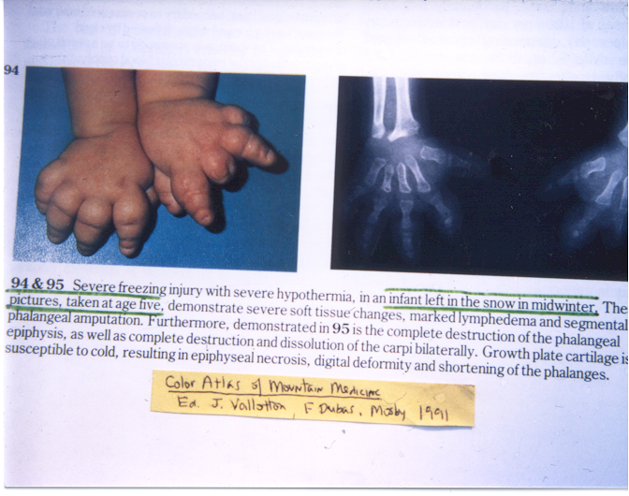

Slide 19
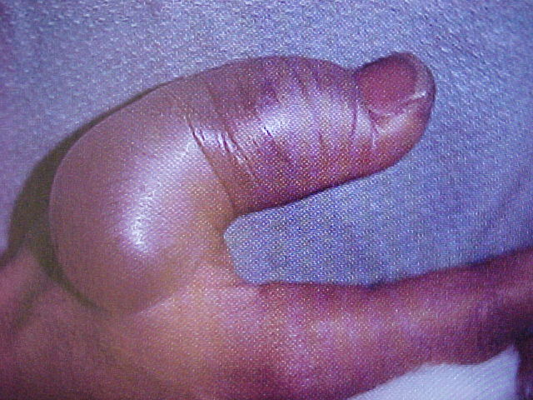

Slide 20
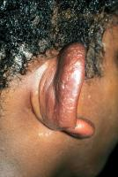

Slide 21
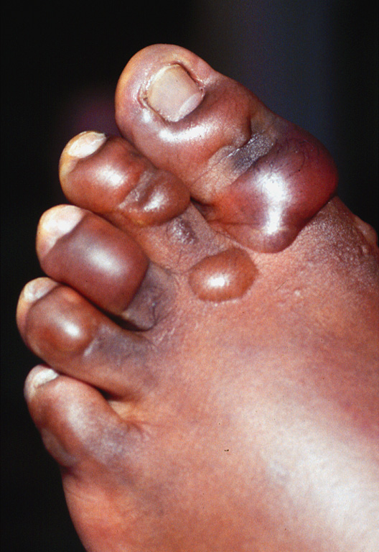
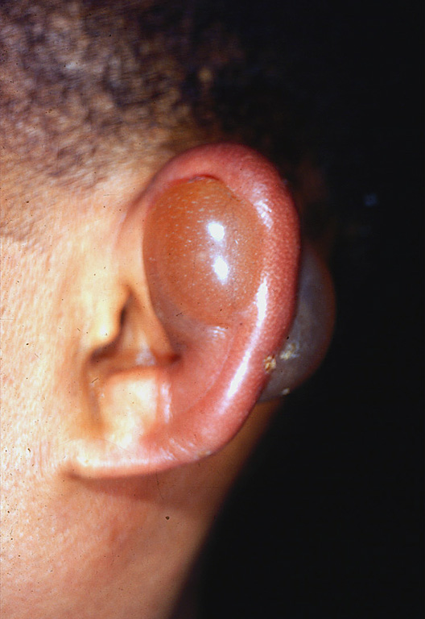

Slide 22
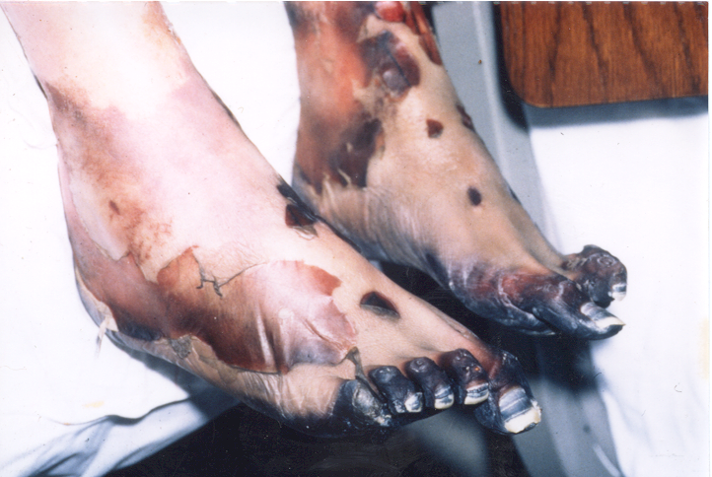

Slide 23
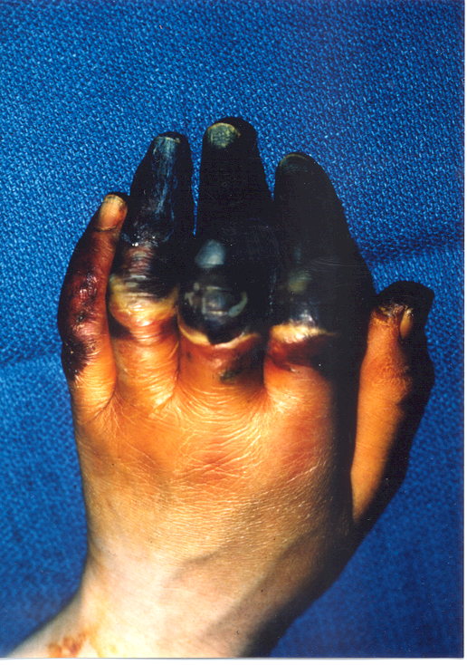
These fingers can not be saved, and will result in amputation

Slide 24
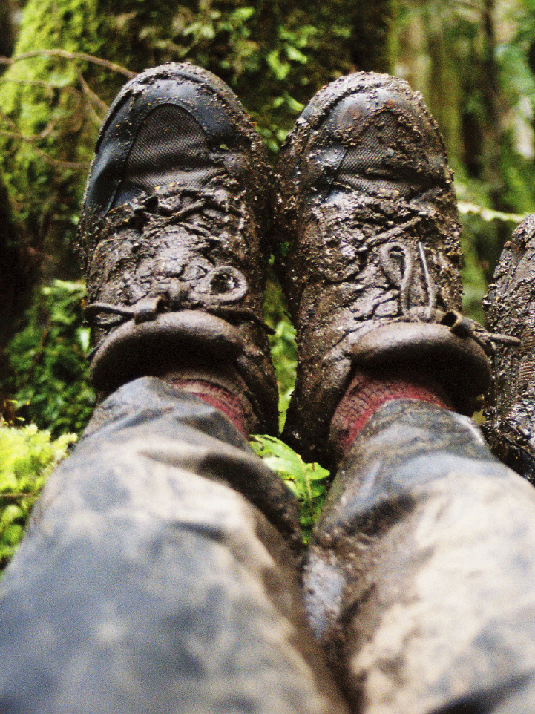
Immersion Foot
What is it? -Prolonged exposure to cold wet conditions. -Inactivity, damp footwear speed onset and severity. | Symptoms: -Cold, numb feet -May progress to hot with shooting pains -Swelling, redness, bleeding
Prevention: -Keep feet warm, clean and dry with frequent sock changes -Dry boots overnight by stuffing with paper towels | Treatment: -Re-warm and dry feet by exposing to warm air -Do not bear weight -Do not rub, moisten or expose area to extreme heat -Evacuate

Slide 25
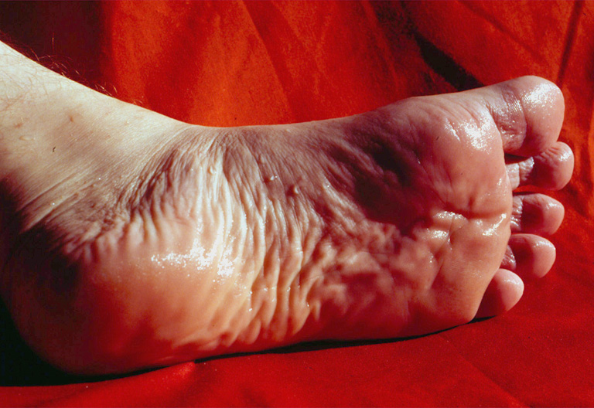

Slide 26
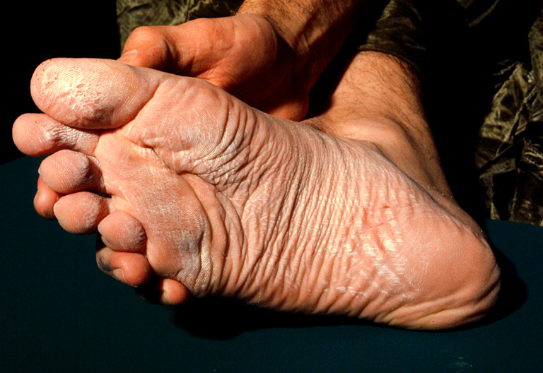

Slide 27
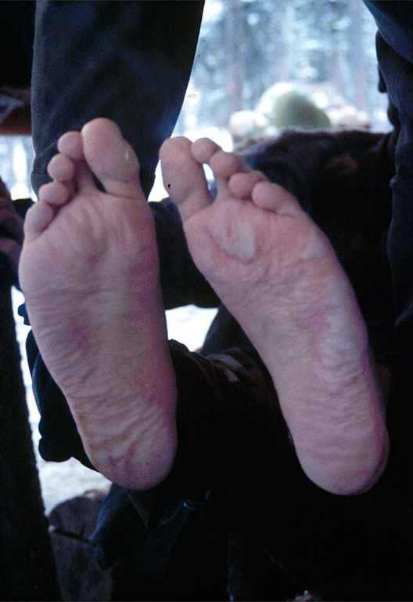
Failure to change socks when wet

Slide 28
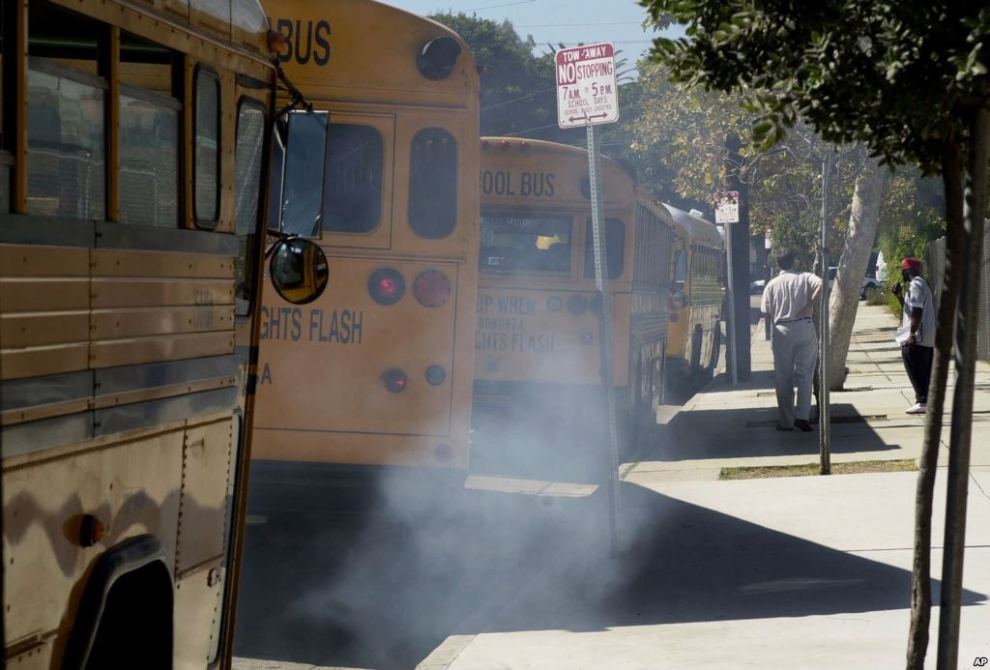
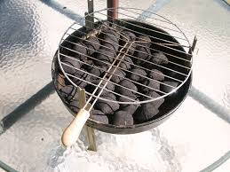
Carbon Monoxide Poisoning
What is it? -Carbon Monoxide displaces Oxygen in blood -Breathing fumes from improperly ventilated heat sources. | Symptoms: Mild: headache, confusion, tiredness, excessive yawning Severe: cherry red lips (grey in dark skinned individuals), unconsciousness
Prevention: Use only approved heaters inside -Don’t idle vehicles next to buildings -Don’t nap in running vehicles | Treatment: Move to fresh air CPR if needed Evacuation

Slide 29
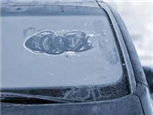
Cold Weather Driving
Car survival kit
-Chains
-Scraper
-Sleeping bag/ blanket
-Water
-High calorie snacks
-Extra gloves
-Hat
-Flashlight
-Candles
Stranded?- Stay with vehicle (usually)
Use your lights always
Clear off windows, lights, hood and roof of your vehicle.

Slide 30
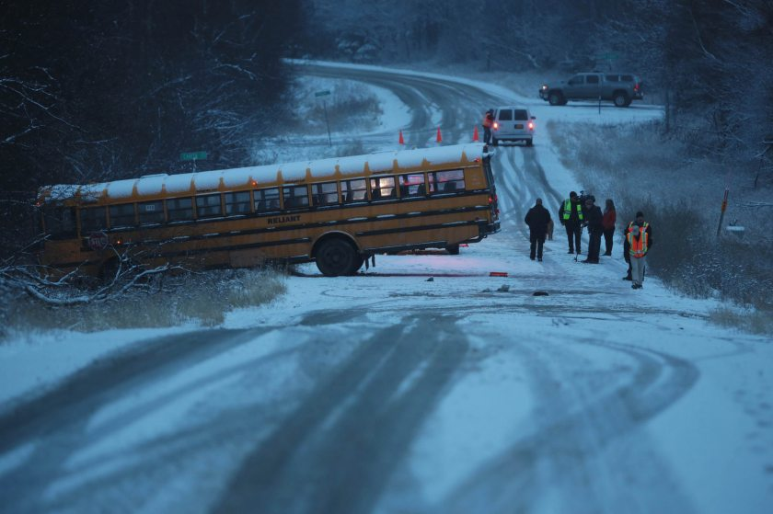
Cold Weather Driving
Posted speeds are for dry pavement
Drive defensively, give yourself a cushion of time to react
Brake early and gently to avoid skidding
Watch for signs alerting you to potential hazards
Don't use cruise control or overdrive
Don't assume your vehicle can handle all conditions

Slide 31
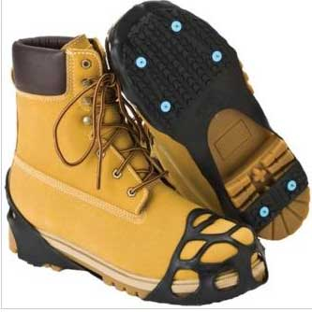
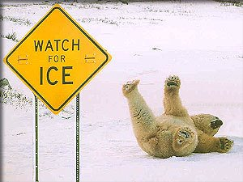
Slips/Trips/Falls
One of the most common injuries during winter
Inside AND outside
Preventable
  Ice-melt/snow-ice removal
  Mopping/signage
  Move with care
  Proper lighting
  Appropriate footwear

Slide 32
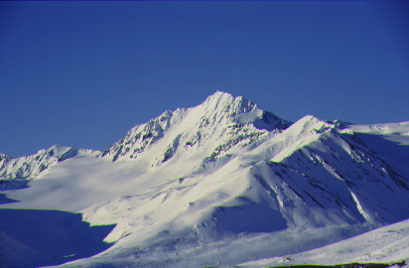
Summary

