Slide 1


Asbestos Awareness
Courtesy of Schools Insurance Authority and Shasta Trinity Schools Insurance Group

Slide 2
Agenda
The law in summary
What is asbestos?
Why is asbestos harmful?
Where is it commonly found?
What does the law tell us?
What precautions should I take?
What else should I know?

Slide 3
The Law in Summary
Testing
Abatement
Re-testing

Slide 4
Testing
A reputable and licensed company must be hired to perform testing
Air samples and surface samples are obtained and tested in a lab
Surfaces vary: floor and ceiling tiles, wallboard, concrete and composite pipes, etc
If asbestos is found, abatement must take place

Slide 5
Abatement (1 of 2)
Only registered and licensed asbestos abatement companies are permitted to perform abatement
Workers must wear protective gear and have respirators
An area to change clothing/equipment must be established to prevent containment to the outside area
Areas must be cordoned off with signs posted as to the danger of asbestos
Abatement areas must be properly ventilated with maintained negative pressure on protective plastic tenting containing the area

Slide 6
Abatement (2 of 2)
Waste materials must be double-bagged and tied in marked color-coded plastic bags
Waste materials must be taken to an approved waste materials site for disposal
Contaminated clothing must be treated as hazardous materials and disposed of properly
Non-friable materials must be properly contained and indicated if removal is not necessary or possible

Slide 7
Re-Testing
After abatement a process of testing is also required.
Inspection passes if area is determined to be successfully abated and free of friable particulates.

Slide 8
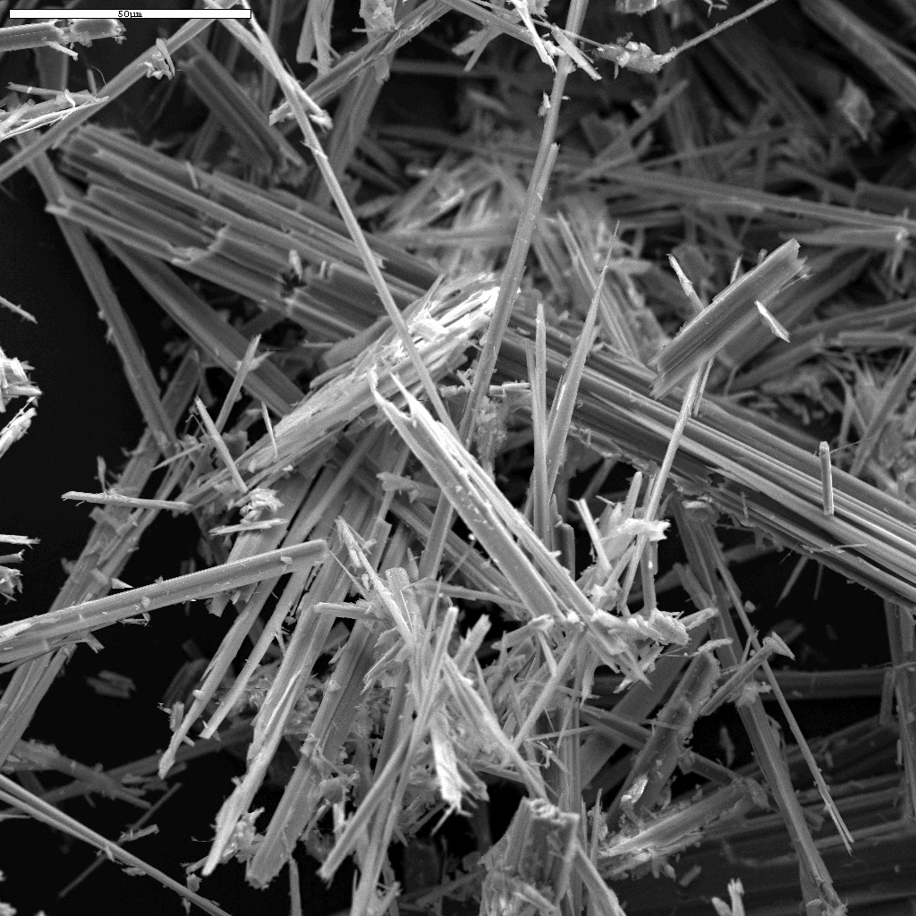
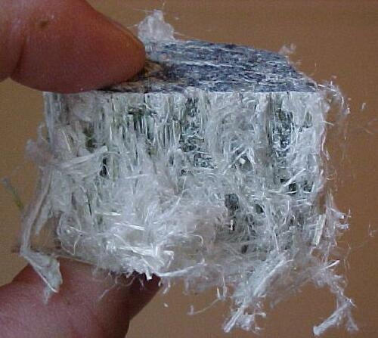
What is asbestos?
Asbestos is a commercial term for certain minerals
  Serpentines
  Amphiboles

Slide 9
Why is Asbestos Harmful?
Asbestosis
  Lung scarring
  Emphysema
Lung Cancer
  13-23x higher if you smoke
Mesothelioma
  No safe exposure level
“Friable”

Slide 10

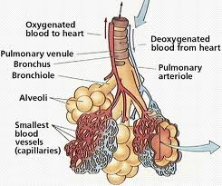
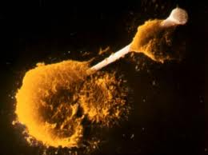
Mechanism of Asbestos Related Disease
Cells to attack the “invader”/fiber.
Attack cells release chemicals. Doesn’t work on asbestos fibers!
Chemicals kill healthy tissue around the fiber.
Causes major scarring of alveoli.

Slide 11
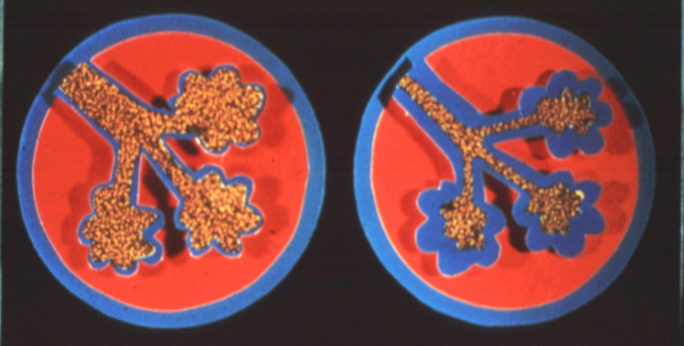
Asbestosis
Scarring of the lung tissue
  Lowers function which stresses other systems
Progressive, degenerative and incurable
First recorded case in 1924
Spirometry lung function tests to assess
Similar to:
Silicosis from Silica Exposure
Byssinosis from Cotton
Pneumoconiosis from Coal
Berylliosis from Beryllium

Slide 12
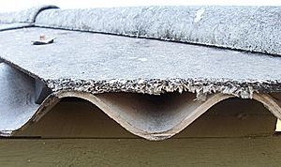
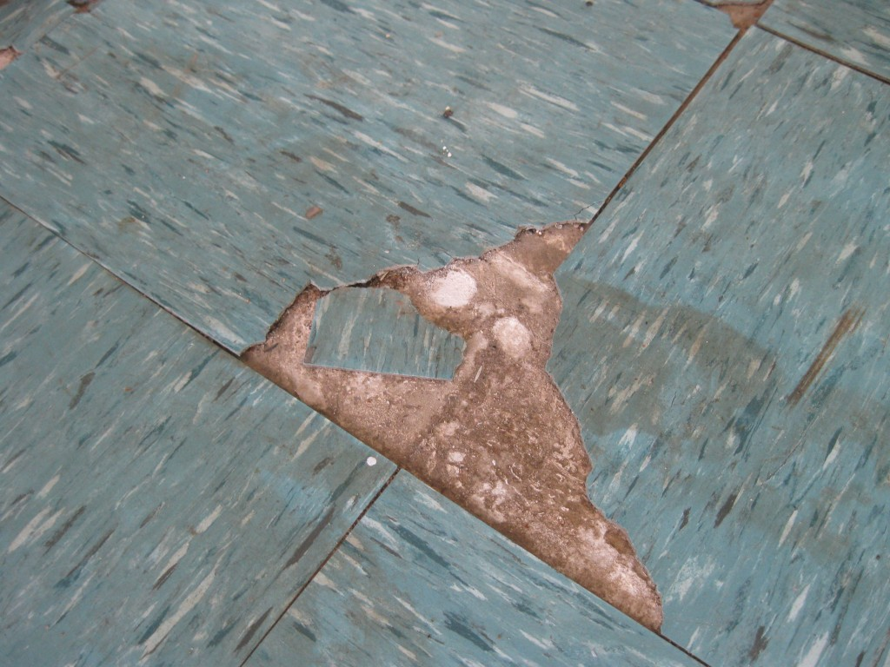
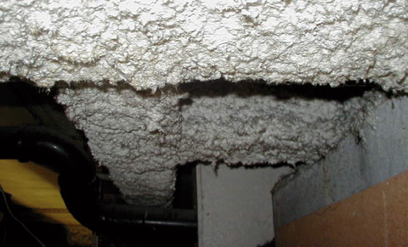
Where is it commonly found?
Ceiling tiles
Flooring
Insulation

Slide 13
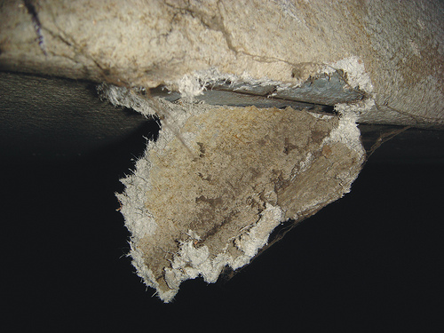
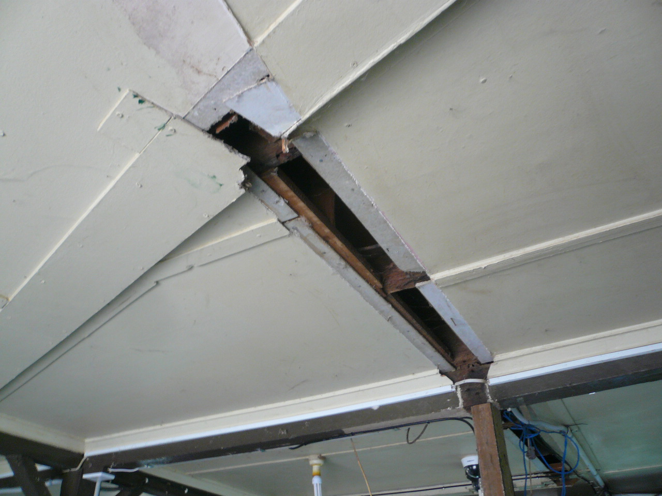
Where is it commonly found?
Drywall mud
Mastic

Slide 14
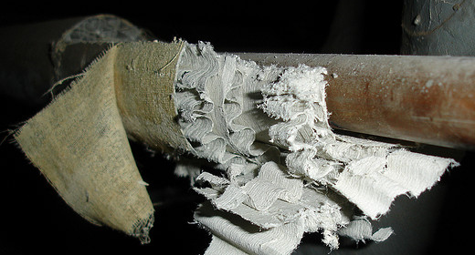
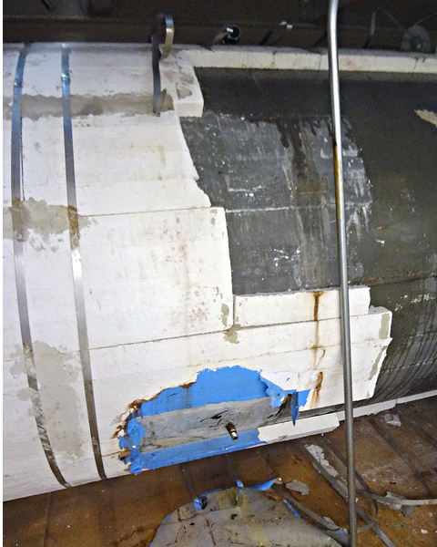
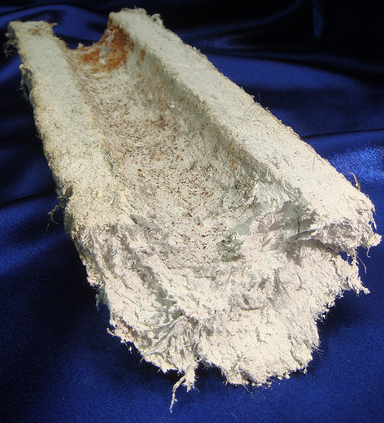
Examples of Common ACM

Slide 15
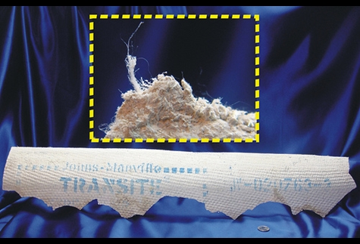
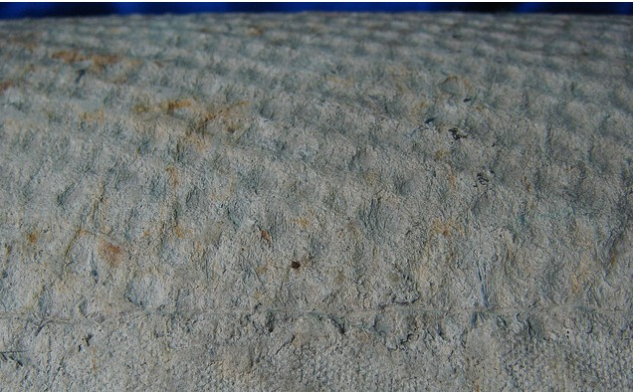
Transite Pipe
12-50% asbestos fiber to provide tensile strength
Fibers act similar to steel in reinforced concrete
Used for water, sewer, gas lines and vents

Slide 16
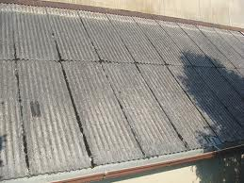
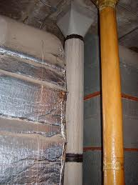
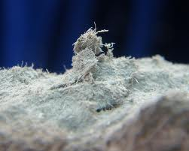
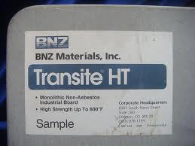
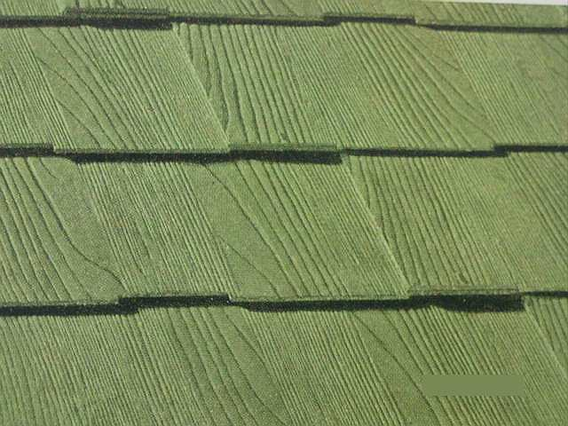
Examples of Transite Materials
Corrugated Transite Panels
Transite Vent Pipe
Non-Asbestos Transite HT Fiber Board -
Contains Crystalline Silica
“Wood” Textured Transite Shingles

Slide 17
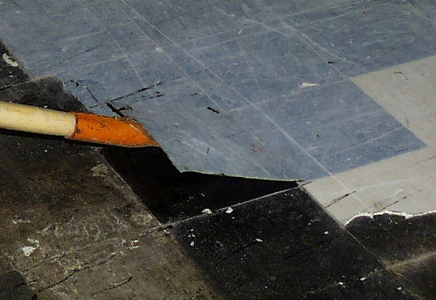
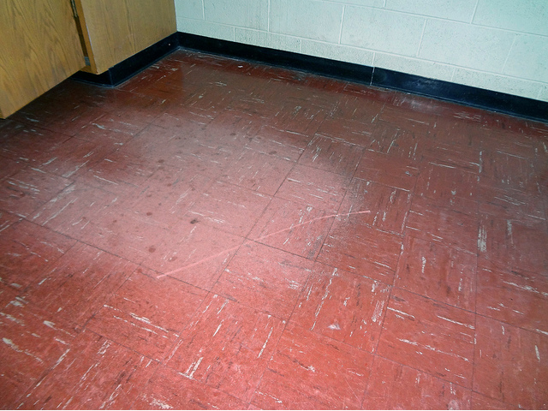
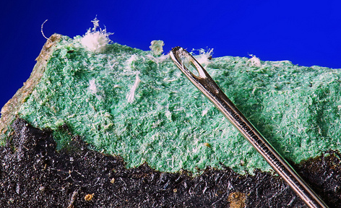
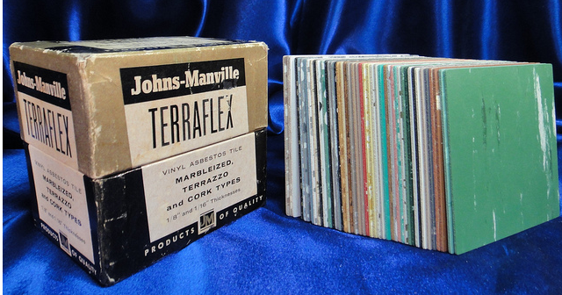
Examples of Common ACM

Slide 18

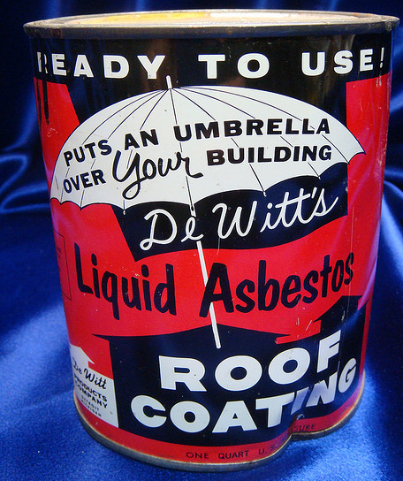

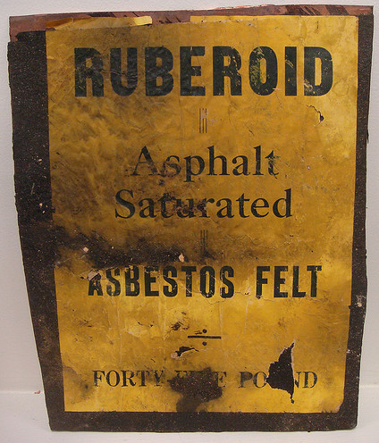
Examples of Common ACM

Slide 19
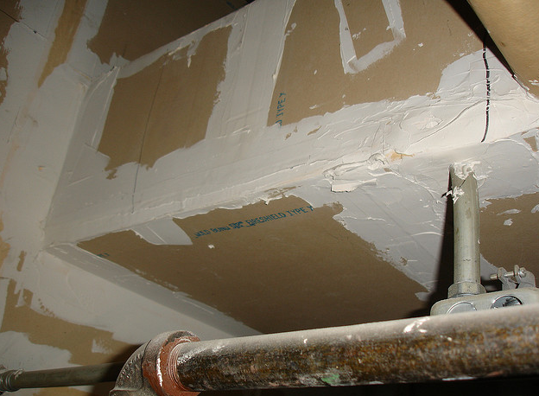
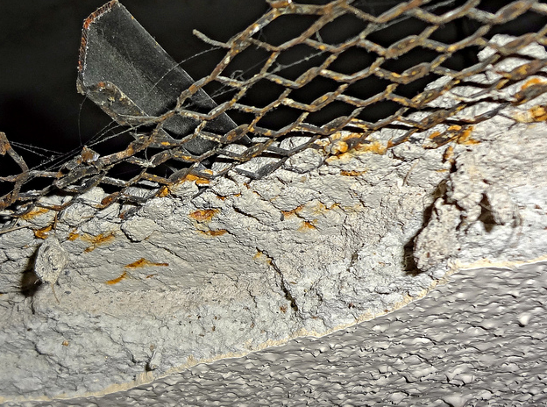

Examples of Common ACM

Slide 20
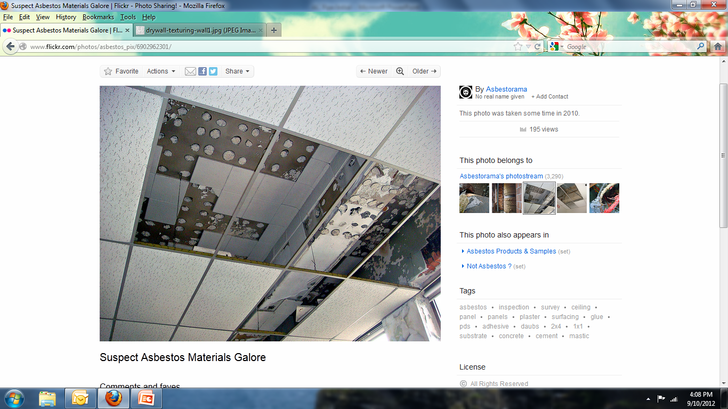
Examples of Common ACM

Slide 21
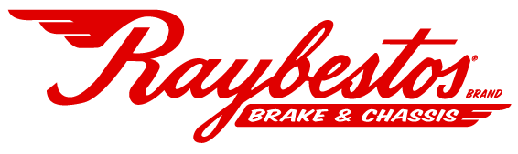
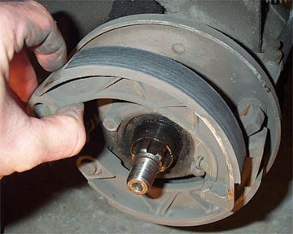
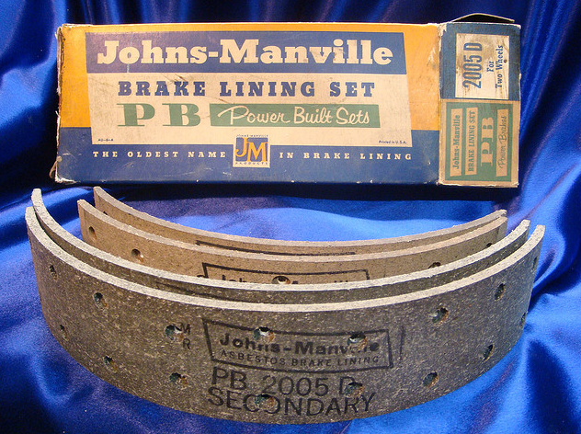
Examples of Common ACM
Notes:
Raybestos brand was manufactured by Raymark Industries, Inc in Stratford Connecticut from 1919 until 1989 manufacturing asbestos brake linings and other automotive asbestos products. The owners declared bankruptcy due to asbestos lawsuits and sold the brand.

Slide 22
What does the law tell us?
Asbestos Hazard Emergency Response Act (AHERA) applies to K-12 schools
Inspection required every 3 years if present
Federal law: Testing can only be done by AHERA-accredited Building Inspector

Slide 23
What does the law tell us?
You must have written policies
“Designated Person”
2 hour or 16 hour training required (M&O)
If removing over 100 square feet must be certified by CALOSHA

Slide 24
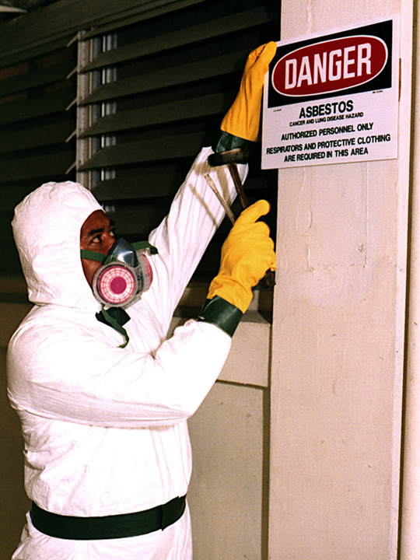
What precautions should I take?
Get training
Control future exposure
Wet suspect materials prior to disturbing
Properly wear correct respirator
Manage in place OR remove asbestos

Slide 25
What else should I know?
After 1985 ABM uncommon
Latency period is 10-40 years
Most asbestos disease from long-term, heavy exposure
Silica (dry ceramic dust) and other contaminants harmful

Slide 26
Review
What is asbestos?
Why is asbestos harmful?
Where is it commonly found?
What does the law tell us?
What precautions should I take?
What else should I know?

